Slide 1
WIC Screenings Immunization, Lead, and Hemoglobin/Hematocrit
Illinois Department of Human Services October 2025

Slide 2
Resources Needed for Training
Illinois WIC Policy: Certification Standards Section 6 and 13
Addenda:
IWIC Flow Sheets
USDA WIC Nutrition Risk Manual
IWIC Nutrition Risk Criteria
Biochemical Collection Guidance
NPS Documenting in WIC MIS
Community Health Training Center
https://springfieldul.org/chtc/resources/wic-policy-and-procedure-manual

Slide 3
Policy Review: Certification Standards Section 6 & 13
Section 6.1 Assess General Information
Section 6.3 Biochemical Assessment
Section 6.4 Deferral of Anthropometric and Biochemical Data
Section 13.3 Immunization Screening and Referral
Section 13.4 Blood Lead Screening

Slide 4
Why Change?
Nutrition risk criteria are used to determine eligibility for WIC. Collecting relevant information in an organized and thorough manner facilitates risk assignment.
The Lab screen in the WIC MIS has been re-structured to improve the accuracy of the data being entered and ensure all staff are entering the data in a consistent manner across the state.

Slide 5
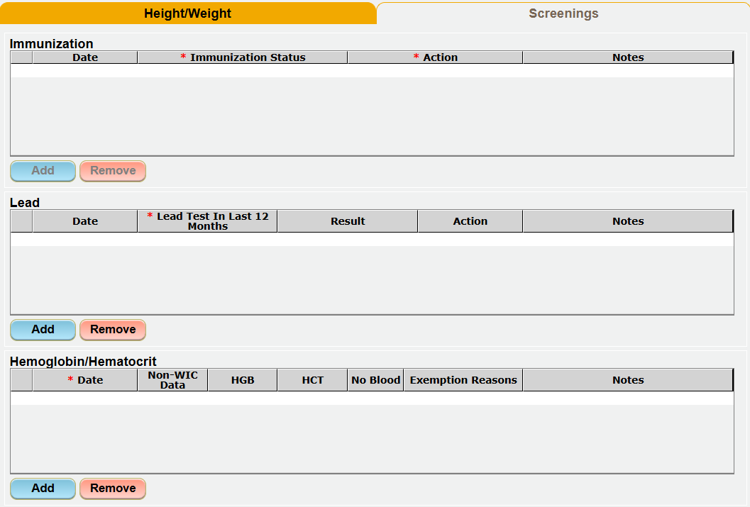
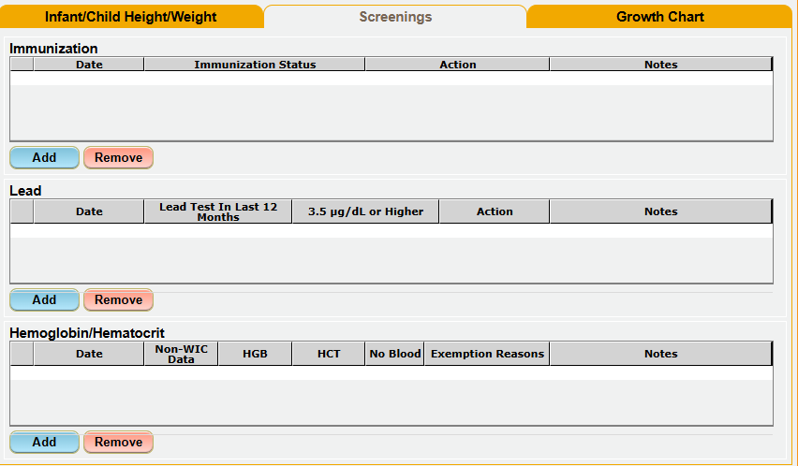
WIC MIS Documentation Updated lab screen

Slide 6
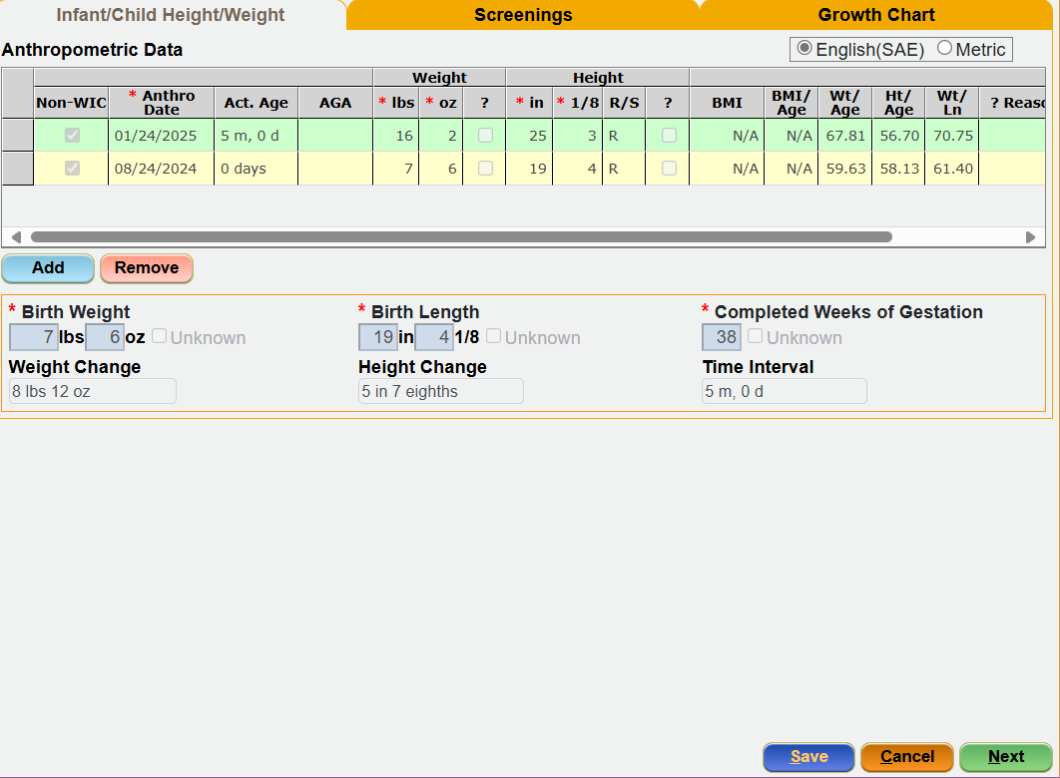
LAB Screen
No changes to the Anthropometric Data grid or the birth/prenatal questions.

Slide 7
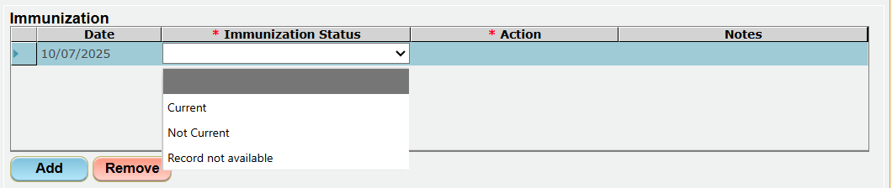
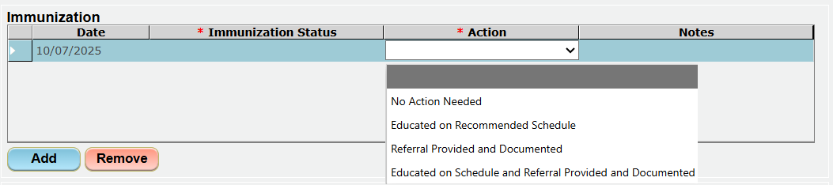
Immunization Screenings

Slide 8
Policy Review: Certification Standards Section 13.3
Section 13.3 – Immunization Screening and Referral
WIC’s role related to infant and child immunization status is to screen & refer:
Screen: Check the immunization status of infants and children during certification and recertification.
Refer: Direct families to health care providers or clinics when immunizations are due or missing.
Must use a documented record.
Immunization records are requested for infants and children during the certification and health screening process; however, immunization records are not required to obtain WIC services.

Slide 9
Immunization Screening
Choice | When to Use
Current | If a documented record is reviewed and status is current
Not Current | If a documented record is reviewed and status is not current
Record not Available | If a documented record is not available, verbal immunization status is not acceptable

Slide 10
Immunization Screening
Action Choice | Status Chosen
No Action Needed | Current Record not Available
Educated on Recommended Schedule | Not Current
Referral Provided and Documented | Not Current Record not Available
Educated on Schedule and Referral Provided and Documented | Not Current Record not Available
Use this guide to determine what Action is needed based on the Status that was chosen.
If caregiver indicates status is current but documentation is not available, it is appropriate to indicate No Action Needed and add a note in the Notes column indicating this information.

Slide 11
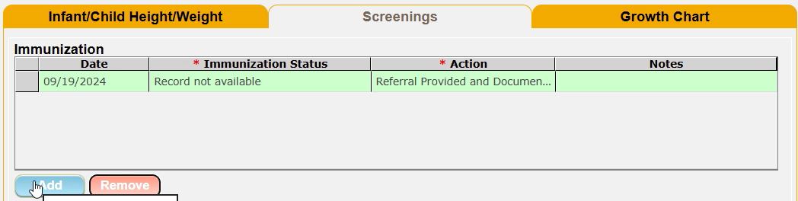
IMMUNIZATION Demonstration
Notes:
Play the screen recording for a demo

Slide 12
Immunization Screenings
Women
Grid included in the Screenings Tab; however, it is not expected information for women will be added and the ability to Add a row to the grid is disabled.

Slide 13
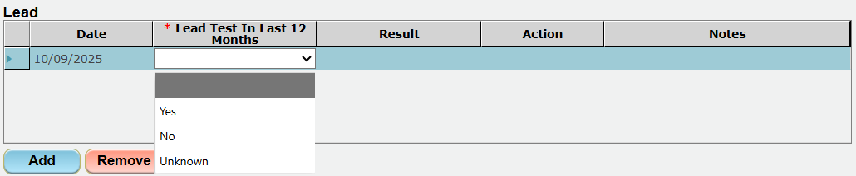
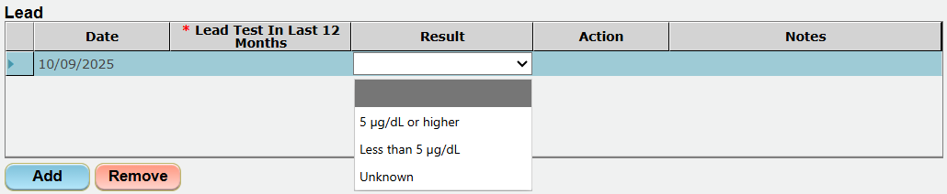
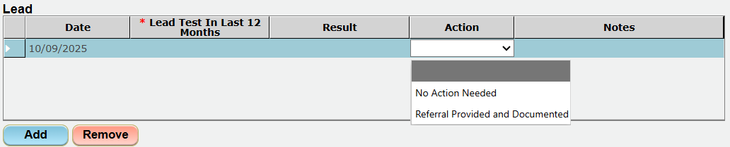
Lead Screening

Slide 14
Policy Review Certification Standards Section 13.4
Section 13.4 – Blood Lead Screening
WIC’s role in lead exposure prevention and reduction is to screen and refer.
As part of the WIC Assessment, all WIC applicants must be asked if they’ve had a blood lead test within the past 12 months.
If yes, staff should include the results in WIC MIS and offer education and counseling as appropriate.
If a child has not received a blood lead test, they must be referred to their healthcare provider or other program to obtain one.

Slide 15
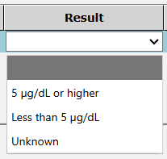
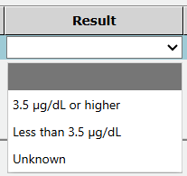
Lead Screening
Values
Women & Infants | 5 ug/dL or higher
Children | 3.5 ug/dL or higher
If the above values chosen, risk would assign
Lead result can be verbal, documentation is not required

Slide 16
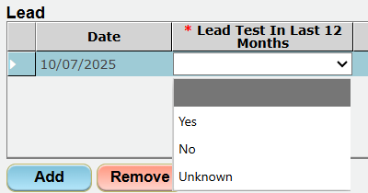
Lead Screening
Choice | When to Use
Yes | If a test has been completed in the last 12 months
No | If a test has not been completed in the last 12 months
Unknown | If it is unknown whether a lead test has been completed in the last 12 months

Slide 17
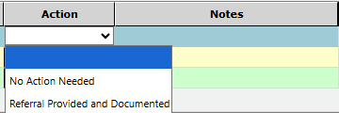
Lead Screening
Lead Test in Past 12 Months? | Value | Action
Yes | 5 ug/dL or higher 3.5 ug/dL or higher | Referral Provided and Documented No Action Needed
Yes | 5 ug/dL or less 3.5 ug/dL or less | No Action Needed
Value will be blank if response to Lead Test in Past 12 Months is No or Unknown
If caregiver indicates Yes, lead test in the last 12 months and result is high, it is appropriate to indicate No Action Needed if being followed by health care provider and add a note in the Notes column indicating this information.

Slide 18
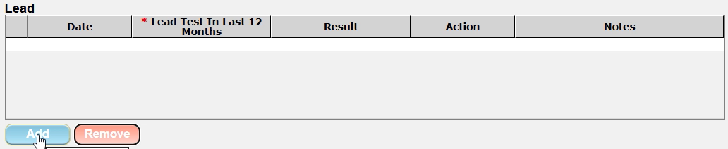
Lead Demonstration
Notes:
Play the screen recording for a demo

Slide 19
Local Agency & Blood Lead Screening
Question – Our agency provides blood lead testing; how would we document that?
Answer – If the blood lead test has not been completed within the past 12 months at the time of certification, mark “No” under the “Lead Test in Past 12 Months” and select “Referral Provided and Documented” in the Action column. Once your agency’s lead program receives the test results, staff should add a new row in the lead grid with the updated information.

Slide 20
What does Provided and Documented Mean?
Referral Provided and Documented
A Referral to Lead Prevention/Screening is added on the Referrals screen, and if applicable a Community Resource is added.

Slide 21
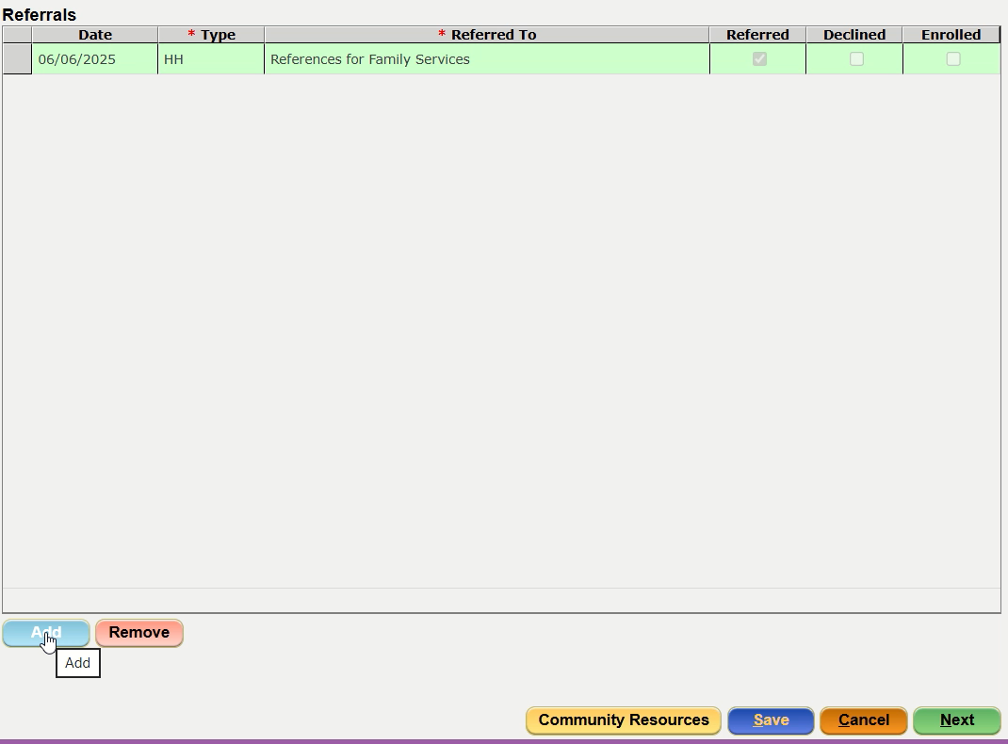
Referral Demonstration
Notes:
Play the screen recording for a demo

Slide 22
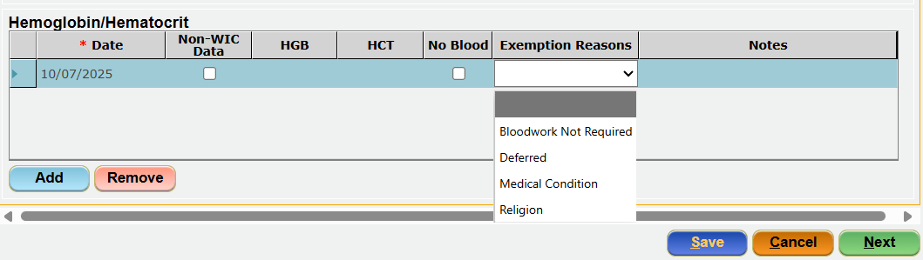
Hemoglobin/Hematocrit Screening

Slide 23
Policy Review: Certification Standards Section 6.3
Biochemical Assessment
Typically, anemia screening is conducted at the following timeframes. For specific requirements, refer to policy.
Infants: Between nine and twelve months if certified at 6 months or older
*Children: During the 1-year certification and annually thereafter
Women:
Pregnant women collected at the earliest opportunity during pregnancy
Breastfeeding and postpartum women, ideally completed 4-6 weeks after delivery
*When test results indicate anemia, a follow-up blood test is recommended at 6-month intervals until the results are in normal range.

Slide 24
Hemoglobin/Hematocrit Screenings
Changes:
Title of the grid changed from Bloodwork to Hemoglobin/Hematocrit
Removed | Added | Moved & Renamed
Date Created | Notes | Non-WIC to Non-WIC Data
Lead |  | Date of Bloodwork to Date
Notes:
No changes related to functionality, how or when data is entered.

Slide 25
Conversion of Data
Data collected and entered from the previous version of the Immunization Status and the Bloodwork grid will be converted as applicable and transferred to the new grids.

Slide 26

What is required?
Refer to policy for specific requirements related to the timelines for the various screenings. For the WIC MIS, if a row is added to the grid, the columns with a red asterisk (*) are a required field.

