Slide 1






Healthy Eating on a Budget
WIC Talks
Notes:
SAY: Welcome everyone! Today’s topic is Healthy Eating on a Budget, where will discuss planning and shopping. Healthy eating doesn’t have to be expensive or complicated and with a little planning and smart shopping you can make the most of your WIC benefits while feeding your family nutritious meals.

Slide 2
Learn
Learn how to plan affordable, healthy meals using WIC-approved foods
Create
Create smart shopping strategies to make the most of your WIC benefits
Discover
Discover practical ways to save money while choosing nutritious foods for your families.
Goals
Notes:
SAY: By the end of this session you will walk away with 3 key takeaways. (Review slide)
SAY: We hope to provide you with tools and ideas you can start using right away.

Slide 3

Welcome!
Please tell us:
Your name
The number of people in your household
One thing you hope to learn about healthy eating on a budget today
Notes:
SAY: Before we dive in, let’s take a moment to introduce ourselves. I will start (introduce yourself)
SAY: Now I’d like to hear from each of you. Please share your name, how many people are in your household and one thing you hope to learn about healthy eating today. It could be something like tips for saving money, finding new meal ideas or even how to get your family to try new foods.
Note:
for virtual classes SAY: You can either type in the chat or raise your hand and we can call on you.
For in person classes SAY: Raise your hand and we can call on you.

Slide 4

What “go-to” meal do you make when you want something quick, easy and affordable?
Notes:
SAY: Let’s start with some quick idea-sharing to get everyone thinking about food and budgeting. (Read question on slide)
SAY: This could be a favorite recipe you make when you’re in a rush, something that’s budget-friendly or maybe a meal your family loves that doesn’t take much time or effort.

Slide 5
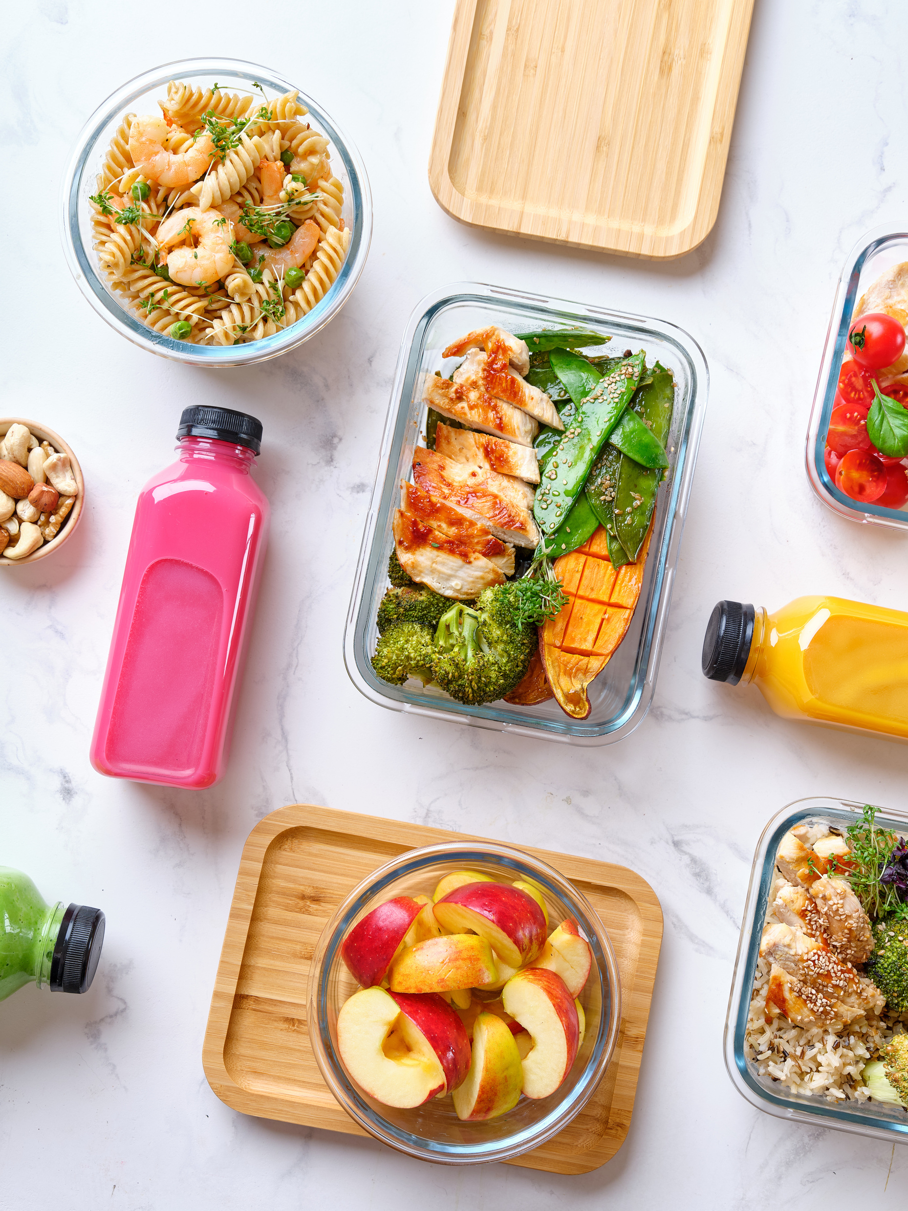
Review
Plan
Shop
3 Steps
to Success:
Notes:
SAY: To make healthy eating on a budget easier, we will focus on 3 simple steps Review, Plan and Shop.
SAY: REVIEW: Start by looking at what you already have at home by checking your pantry (or cupboard), fridge and freezer.
SAY: PLAN: Once you know what you have, it’s time to plan your meals. This is when you will search for recipes and make a grocery list.
SAY: SHOP: Finally, head to the store with your list in hand using some tips and tricks we will cover in this presentation to make smart choices, stretch your food dollars and bring home nutritious food for your family.
SAY: Now let’s talk about each step in a little more detail.

Slide 6
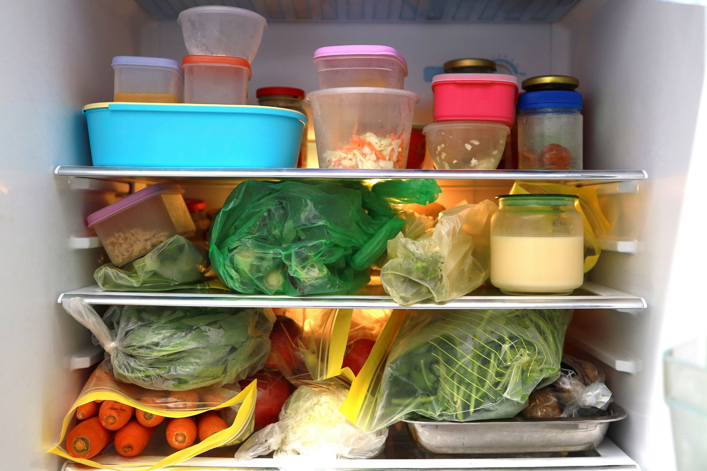
Review
Foods you already have
Family calendar
WIC benefit balance
Notes:
SAY: Before you head to the store its important to take a few minutes to see what you already have at home. This helps you avoid buying more than what you need and ensures you use what you have before it goes to waste.
SAY: Think about your schedule for the week. Are there busy days when you might need quick meals? Do you have any special events coming up that would require extra food?
SAY: Next review your WIC benefits balance so you can use all your items before they expire. We’ll go over how to check your WIC balance in the next few slides.

Slide 7
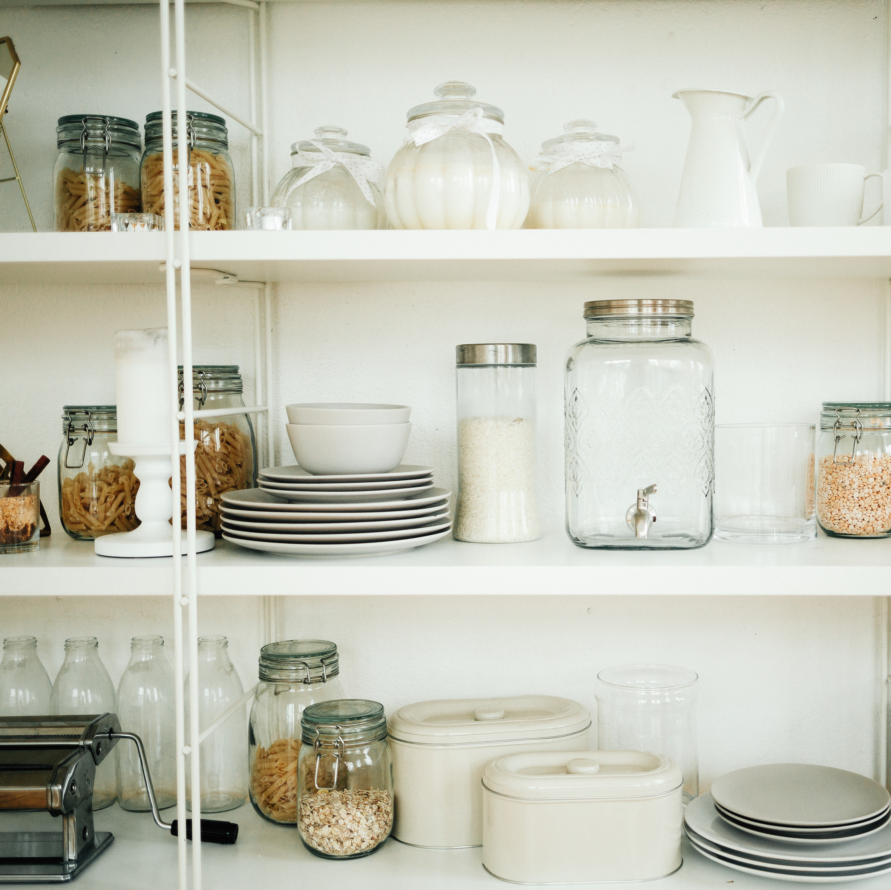
Start With What You Have!
Check fridge and freezer
Find cupboard/pantry basics
Use food that is about to expire!
Notes:
SAY: Taking inventory of your kitchen is a key step in saving money and making the most of what you already have. Before you plan your meals or head to the store, let’s review how to do a quick and effective inventory
SAY: Start with your fridge
Check for fresh produce, dairy and any leftovers
Look for items that need to be used up soon like veggies starting to wilt or milk nearing its expiration date. Plan meals around these ingredients to avoid waste
SAY: Move to your freezer
Look for frozen fruits, vegetables, proteins or premade meals that you can include in your week’s meals
Don’t’ forget about leftovers you may have frozen. Those could save time and money this week!
SAY: Finally, check your pantry/cupboards
Look for staples like rice, pasta, beans, canned goods and spices. These are often building blocks for budget-friendly meals.
Organize your pantry/cabinets as you go so you can easily spot what’s available next time you’re planning.
SAY: Make a list of what you already have
Group items by category – produce, proteins, grains, etc.
This will help you see what’s missing and avoid buying duplicates when you shop.
SAY: Taking a few minutes to do this each week helps reduce food waste, keeps your kitchen organized and ensures that you are using your food benefits and budget wisely.
SAY: Now that you’ve taken inventory its time to move on to planning your meals for the week – step two in our process.

Slide 8

Plan Your Meals for the Week
Consider meals and snacks for:
Work
School
Trips
Special events
Tip: A planner or calendar can help track of your family’s schedule and meals easily!
Notes:
SAY: Planning your meals around your family's schedule is a great way to make sure you have just enough food on hand to meet your family's needs. First think about your meal needs (including snacks) for the week. For example, ask yourself:
how many breakfasts, lunches, dinners and snacks will I need to prepare?
Do I need to pack meals for work, school or other events away from home?
Are there any special occasions this week like birthdays or holidays that might require extra food?
SAY: Using a planner or calendar can help you keep track. We will look at creating a meal plan in a bit.

Slide 9

Review WIC Benefit Balance and Budget
Check your WIC benefit balance using
The BNFT app
Your family shopping list
Recent grocery store receipt
If you receive SNAP benefits, find out that balance as well
Decide how much money you can spend on groceries for the week.
Notes:
SAY: Let’s talk about how to review your WIC benefits and overall budget to prepare for smart shopping.
SAY: To check your WIC benefit balance, you can use your BNFT App, your most recent family shopping list or a recent grocery store receipt to see what benefits are available. This will tell you exactly what foods you can get with your WIC benefits such as milk, fruits, vegetables or cereal.
SAY: If you have SNAP benefits, check that balance too. Knowing your SNAP balance is another important part of planning. Combining WIC and SNAP benefits together can help cover more of your food needs.
SAY: Once you know your WIC and SNAP balances, figure out how much additional cash you can spend on groceries to cover any other items you need. This step helps you stay within your budget while still getting everything you need.
SAY: By reviewing your WIC benefits, SNAP balance (if applicable), and overall budget, you’ll have a clear picture of what you have to spend. This step sets you up for success by helping you avoid overspending and make the most of your benefits.
SAY: Does anyone have any questions about this step in the process? (pause to give attendees a chance to ask questions)
SAY: Great! Now that we’ve reviewed our benefits and budget, the next step is planning meals and creating a shopping list to stay organized and efficient!

Slide 10

plan
Look for recipes using resources like:
MyPlate.gov
WIChealth.org
Swap recipe ideas with friends or WIC staff
Make a grocery list
Notes:
SAY: Finding budget-friendly recipes and planning ahead can make healthy eating easier and more affordable.
SAY: Start by looking for recipes that use simple, inexpensive ingredients you may already have at home, like beans, rice, canned vegetables, or eggs. Websites like the USDA’s MyPlate, WIC Works, or even quick online searches for ‘healthy budget meals’ can help you find ideas that fit your family’s needs. And don’t forget to ask family and friends for some of their favorite recipes! Sometimes a simple recipe swap or suggestion can introduce you to something new and affordable.
SAY: Once you’ve picked a few recipes, make a list of the groceries you’ll need. Start by checking what you already have at home so you’re not buying duplicates. Then, write down only what’s missing. Sticking to your list at the store helps you stay on budget and avoid impulse purchases.
SAY: Try to focus on recipes that use similar ingredients so nothing goes to waste. For example, if a recipe calls for spinach, look for other meals where you can use the rest of the bag, like in soups or omelets. Planning meals this way saves time, money, and effort, making it easier to stick to your goals.

Slide 11
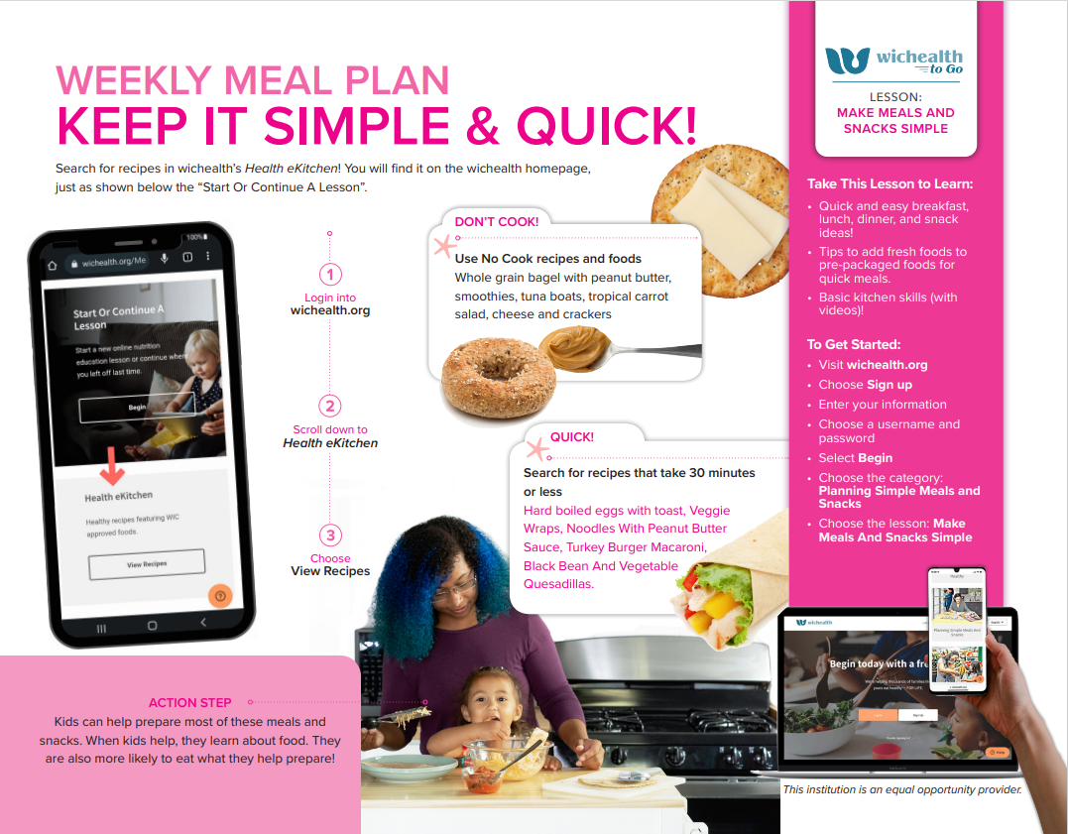
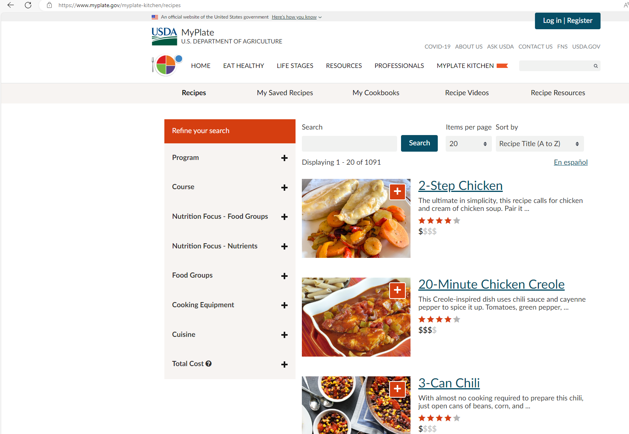
Finding Recipes
Notes:
SAY: WIChealth.org and MyPlate are two trusted sources that offer a variety of recipes, including family-friendly, budget-friendly, and nutritious options. You can search recipes by ingredient or meal type to find exactly what you need.
SAY: Save your favorite recipes for the future. Keeping a small collection of tried-and-true meals makes planning faster and ensures you stick to healthy and affordable choices

Slide 12
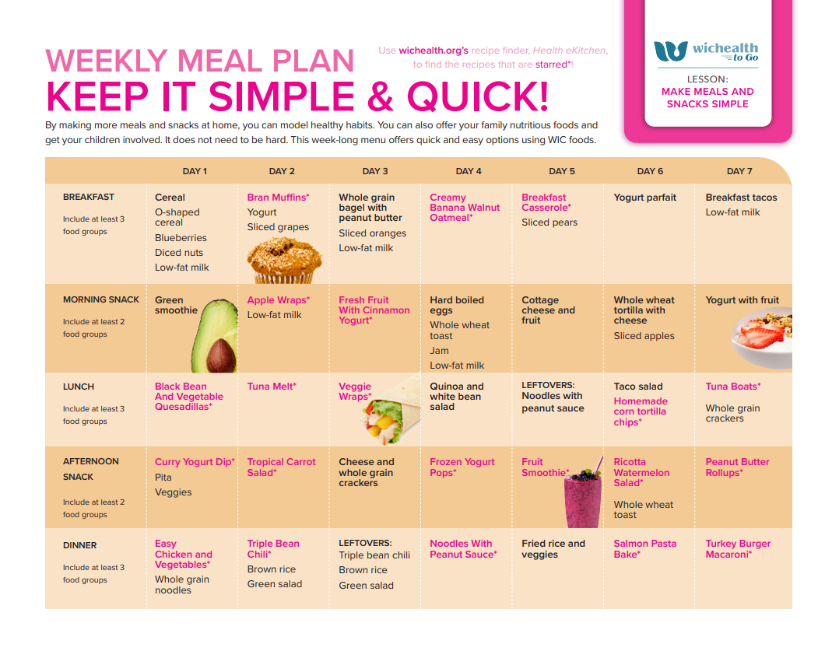
Create a meal plan
Notes:
SAY: Check out this great sample meal plan from WICHealth! This sample uses affordable ingredients and includes foods from WIC benefits. It’s designed to show you simple planning can make meals both healthy and budget-friendly.
Note: If time allow you may want to demonstrate how to access this feature in WIChealth.

Slide 13

Create Your Shopping List
Make a list of ingredients needed for meals and snacks.
Organize your list by store sections (produce, dairy etc).
Include WIC-approved foods like milk, grains, and fruits.
Notes:
SAY: Now that you’ve planned your meals and found your recipes, it’s time to move on to the next step—creating your shopping list. Having a clear and organized list will help you stay on track, avoid impulse purchases, and ensure that you have everything you need for the week.
SAY: First, start by writing down all the ingredients you’ll need for your meals and snacks. Be sure to list specific amounts to avoid buying too much or too little. This will help you stay organized and reduce waste.
SAY: Next, organize your list by sections, like produce, dairy, grains, and proteins. This way, when you’re in the store, you can go through each section without having to backtrack. It will save you time and make your shopping experience smoother.
SAY: Don’t forget to include your WIC-approved foods! Your WIC benefits cover things like milk, whole grains, fruits, vegetables, and cheese. Make sure to check which of these items you’ll need, so you can maximize the value of your benefits and get the most out of your shopping.
SAY: Finally,

Slide 14

SHOP
Smart Shopping Habits
Aisle by Aisle
Unit Pricing
Notes:
SAY: Now that we have assessed our needs and have a plan of action, let’s move on to our final step of the process – shopping!
SAY: In this section, we’ll be discussing some of the little things you can do as you make your way around the grocery store that will save you big money. We’ll go through the store aisle by aisle and review what are some inexpensive (yet healthy) food options for you and your family. Lastly, we’ll touch on unit pricing, and how this simple trick can keep the cost of your grocery cart low.

Slide 15
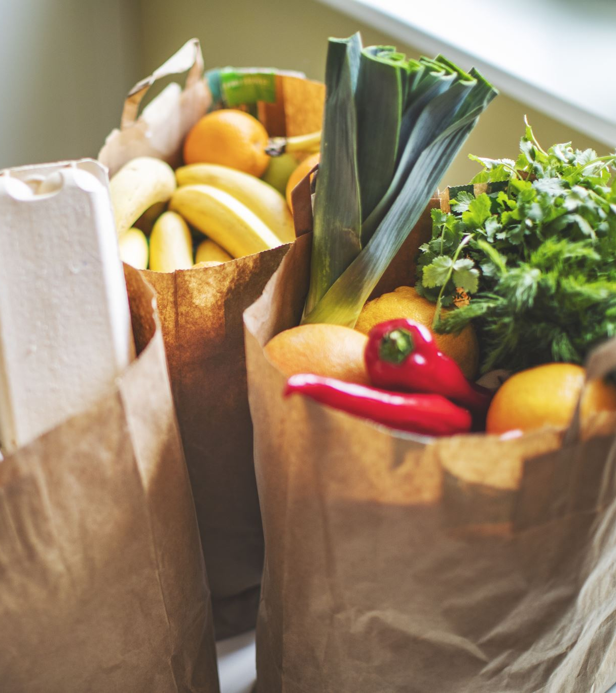
Smart Shopping Habits
Stick to your shopping list
Choose store brands
Look for savings
Store websites and apps
Digital or paper coupons
Notes:
SAY: There are a lot of little things we can do to save money while we shop. Here are a few tips:
SAY: Stick to your shopping list. It's easy to grab items that aren’t on your list but only buying items on your shopping list will help you stay focused on what you need for your meals will help you avoid unnecessary purchases wasting money on things you don’t need.
SAY: Choose store brands
Store brands often provide the same quality at a lower cost
Use unit price to compare with other brands to confirm store brand offers better value (more on this later!)
Many WIC-approved foods are available in store-brand options
SAY: Look for savings
Check store websites and apps for digital coupons
Look for weekly ads and markdowns on frequently used items and stock up on non-perishables when they’re on sale
Buy in bulk long-lasting foods like rice or canned goods. Only buy perishables in bulk if you will use them or freeze them before they expire

Slide 16

Tips for Every Aisle
Grains
Protein Foods
Dairy
Other
Fruits and Vegetables
Buy in Season
fresher, often cheaper, and taste better
Choose Frozen or Canned:
Look for 100% juice and vegetables "low-sodium" or "no salt added” and without added sauces or butter
Choose Whole Grains: Look for 100% whole grain foods (whole wheat bread, brown rice, oats)
Frozen Grains: Convenient options like steam-in-bag rice available in the frozen aisle
Affordable Protein Options
Canned beans, eggs, lentils and canned fish
Buy in Bulk: Freeze portions
Choose lean meats chicken, turkey or lean ground beef
(93% lean/fat-free)
Choose Low-Fat or Fat-Free Same amount of calcium but less fat and fewer calories than whole milk
Buy Plain Yogurt add your own fruit for natural sweetness freshness
Choose water instead of sugary drinks
Take a reusable water bottle when on the go.
Skip the chip and cookie aisle.
Notes:
SAY: Every section of the grocery store includes opportunities to save money and keep your family healthy. Let’s discuss a few from each section: (click on one section at a time)
(Fruits and Vegetables) SAY: In the produce section, look for in-season produce. This produce will often be cheaper and higher quality than out-of-season produce. Be sure to buy only what you’ll use! Check the Seasonal Produce Guide to know what’s in season. You can also look through the canned and frozen fruit and vegetable aisles to see what items on your list may be available for a better price. Canned and frozen fruits and vegetables are often cheaper than fresh, last longer, and are just as healthy as their fresh counterparts.
(Grains) SAY: Now let’s talk about grains. First choose whole grains whenever you can. Look for foods that list whole grains as their first ingredient such as whole wheat bread, brown rice or oatmeal. Whole grains are packed with fiber and nutrients that support overall health. Second frozen wole grains items like whole grain waffles or ready to hat brown rice can be a great time-saver and still provide a healthy, filling option for your meals.
(Protein Foods)
SAY: Affordable Protein Options: Canned beans, eggs, lentils, and canned tuna or salmon are budget-friendly, shelf-stable, and versatile. They can be easily incorporated into various meals.
Purchasing larger bulk items such as chicken, turkey, or lean ground meat can save money. You can then divide the portions into smaller amounts and freeze for later use.
Opt for lean meats like chicken or turkey to reduce fat intake. If you buy ground beef, choose lean cuts, ideally 93% lean or fat-free.
(Dairy)
SAY: Choose low-fat or fat-free dairy instead of whole milk. You still get the same calcium, but with less fat and fewer calories.
• Buy plain yogurt and add fresh or frozen fruit at home. This adds natural sweetness without extra sugar.
• Always check expiration dates to make sure your food stays fresh longer.
Focus on picking WIC-approved dairy first to make the most of your benefits. You can add other items if needed after that.
(Other)
ΣΑΨ: Choose water instead of sugary drinks. Water is free, healthy, has zero calories and it's a great way to save money and stay hydrated.
• Take a reusable water bottle with you when you go out. Carrying your own water bottle helps you stay on track and avoid buying sugary drinks while on the go.
• Skip the chip and cookie aisle. Avoid aisles with snacks that aren’t WIC-eligible. They can tempt you into buying extra items that cost more and don’t offer much nutritional value.

Slide 17
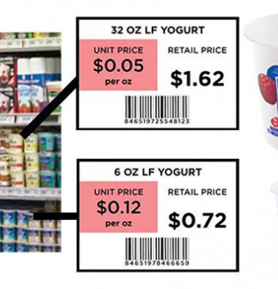
What is Unit Pricing?
Unit price shows the cost of a product per unit (usually ounces or pounds) to help you compare prices and find the best deal.
Tips:
Look for lowest unit price
Store brands often have lower unit prices
Compare different sizes
Notes:
SAY: Using unit pricing helps you understand the cost per unit like per ounce or per pound. For example, a 32 -ounce container of yogurt as you see on this slide has a unit price of $0.05 (or 5 cents) per ounce. This tells you how much you are paying for each ounce of this yogurt. This can be helpful when comparing food prices of different sized containers of the same food such as a 32-ounce container of yogurt with a 16-ounce container etc. As a general rule larger sizes often cost less per unit but not always. So, its always good to check!
SAY: Store brands are usually lower in price than name brands so they can be a smart choice.
SAY: Also, don’t forget to check for sales. Sometimes you can save even more when the unit price drops during special promotions or sales.

Slide 18
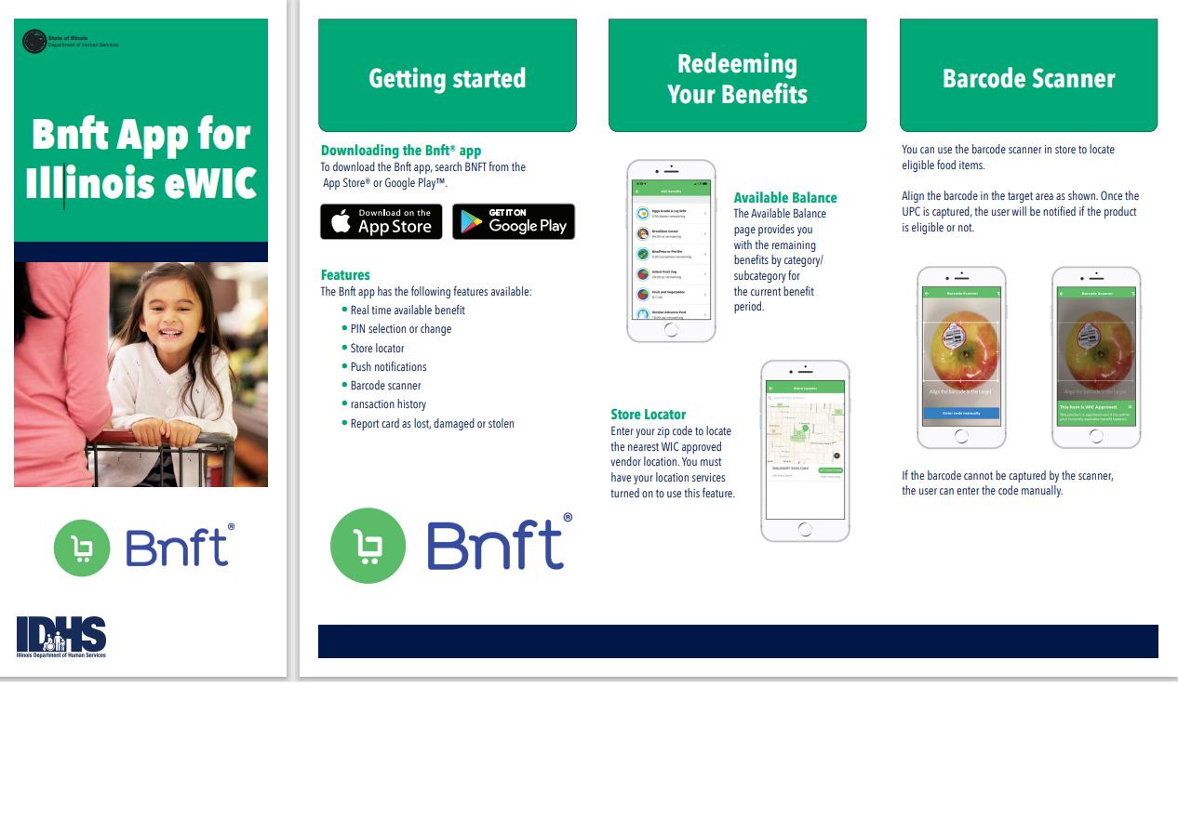
Benefit App Tips
Know your benefit balance:
Use Illinois WIC EBT Card Guide to learn how to check your balance
Scan before you buy:
Use the scanner to confirm eligible items in your local store
Stay informed with updates:
Receive reminders about expiring benefits
Get updates on new eligible items
Notes:
SAY: Now let’s talk about some tips to using your benefit App.
SAY: First know you benefit balance. You can check your benefit balance in the app before you shop to see how to check your balance and maximize your budget. This quick check helps you plan your shopping and avoid surprises at checkout.
SAY:
Next, scan before you buy. Scanning foods before you buy them will help you confirm WIC-eligible items in your local store before you head to the checkout.
SAY: Lastly, stay informed with updates:
Receive reminders about expiring benefits so you don’t miss an opportunity to use your resources
Get updates on new eligible items and food options as your benefits adjust
SAY: Be sure to refer to the handout on the slide for more details about the benefit app.

Slide 19
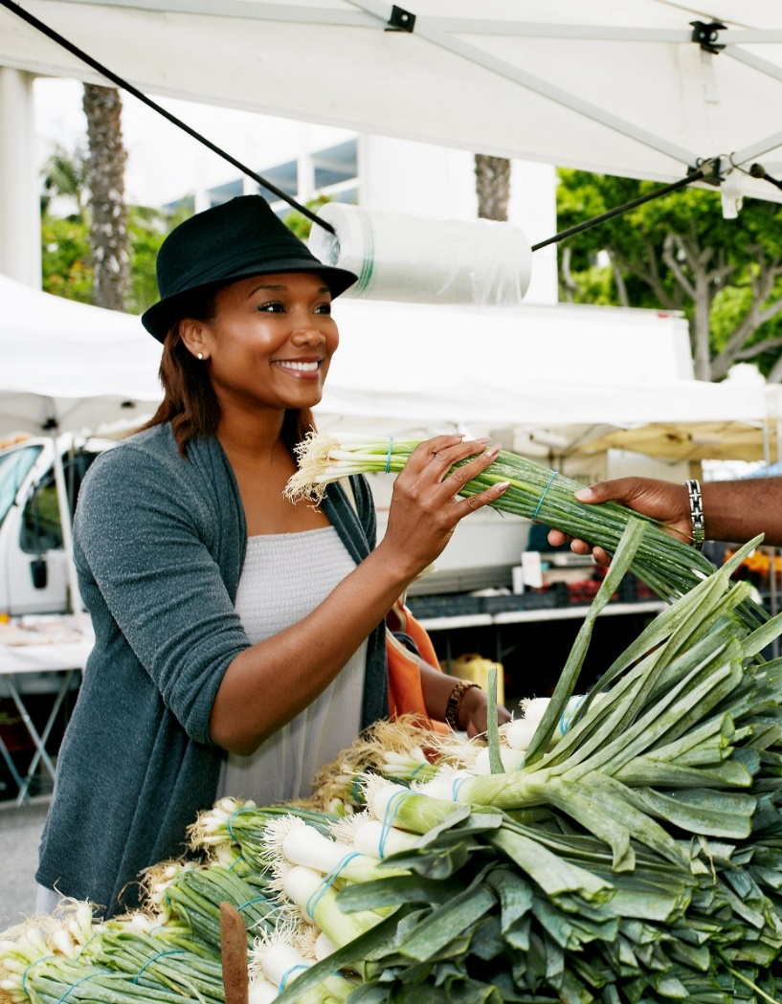
Additional Resources for Affordable Foods
Local Farmer’s Markets
Fresh seasonal produce often at lower prices.
Some WIC clinics provide Farmer’s Market vouchers
School Meal Programs
Free or discounted school breakfast and lunches.
Summer meal programs and other feeding initiatives.
SNAP and Food Pantries
Check SNAP eligibility if not already enrolled.
Find locations through community resources.
“Find Food IL”
Online tool to find nearby pantries, SNAP retailers and farmer’s markets.
Notes:
SAY: There are a lot of great places that you can get food for your family outside of the grocery store.
SAY: Check out Local Farmer’s Markets
Farmer’s markets offer fresh seasonal produce often at lower prices.
Some WIC clinics provide vouchers for participants to use at their local famer’s market – as your WIC Nutritionist if your clinic participates!
SAY: Use School Meal Programs
Free or discounted school breakfast and lunches can help reduce family food costs.
Take advantage of summer meal programs and other feeding initiatives
SAY: SNAP and Food Pantries
See if you are eligible for SNAP benefits if not already enrolled
Visit local food pantries for no-cost nutritious staples.
Find locations through community resources
SAY: Find Food IL is an online tool to quickly locate many food assistance programs for your shopping needs. You just go to the website and enter your zip code.
SAY: Ask your WIC Nutritionist for more information on any of these resources!

Slide 20
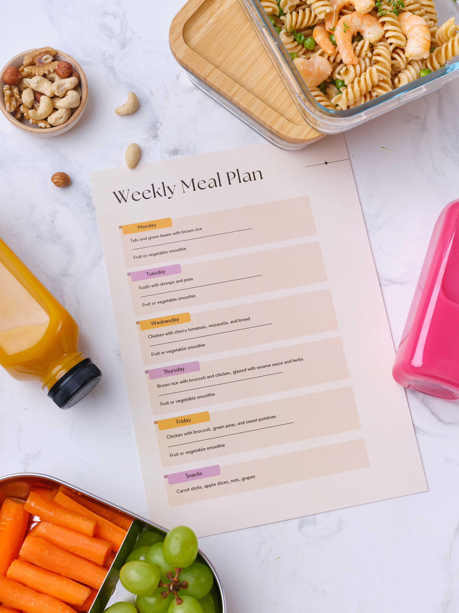
Activity:
Let’s make a
meal plan!
Notes:
SAY: Now that we have a good understanding of all three steps of the budget-friendly meal planning process, we’re going to put what we learned into practice.

Slide 21
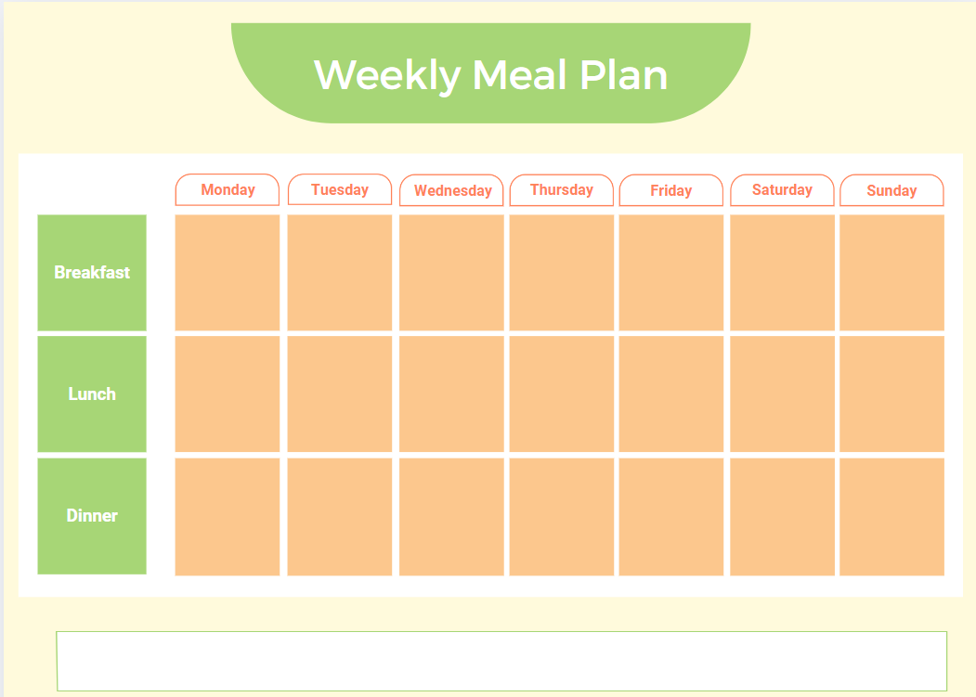
Available food items at home:
Brainstorm: What is a breakfast, lunch, dinner, and snack that you could make for your family using just the foods you have at home, plus your WIC benefits?
Bell peppers
Onion
Oil
Milk
Oatmeal
Ground beef
Walnuts
Whole wheat bread
Garlic
Chicken breast
Soy sauce
Celery
Lemon
Canned tuna
Corn
Lettuce
Spinach
Sour cream
Salsa
Cooking spray or oil
Bananas
Orange juice
Peanut butter
Curry powder
Honey
Carrots
Dried ginger
Salt
Whole wheat spaghetti
Available WIC benefits on your card:
1 quart yogurt
1 package cheese
$20 CVB benefit for fruit/veg
2 cans of beans
1 16 oz box of cereal
Notes:
SAY: Let’s practice the reviewing and planning parts of our process. On the top left side of the slide, you’ll see “Available food items at home with a 3 columns of foods. These are foods that you might have at home (you may not have all of these items at home – we’re just pretending so we can practice these skills!). On the bottom left section of the slide where it says “Available WIC benefits on your card” is a sample list of WIC benefits that you may have on your card (again, this amount is just for demonstration purposes).
SAY: Using the meal planning template provided, you are going to think of a breakfast, lunch, dinner, and snack that your whole family would enjoy using just the ingredients you have at home (listed here on the slide), plus your WIC benefits (also listed here on the slide). These meals don’t have to be fancy. Just be sure to consider what would be realistic for your family on an average day.
SAY: Take about 5-7 minutes to work on this. When you’re finished, we will go around the room and share some of our ideas!
After 5-7 minutes….
SAY: who would like to volunteer and share their meal ideas?
(based on available time either request a few volunteers or go around the room).

Slide 22
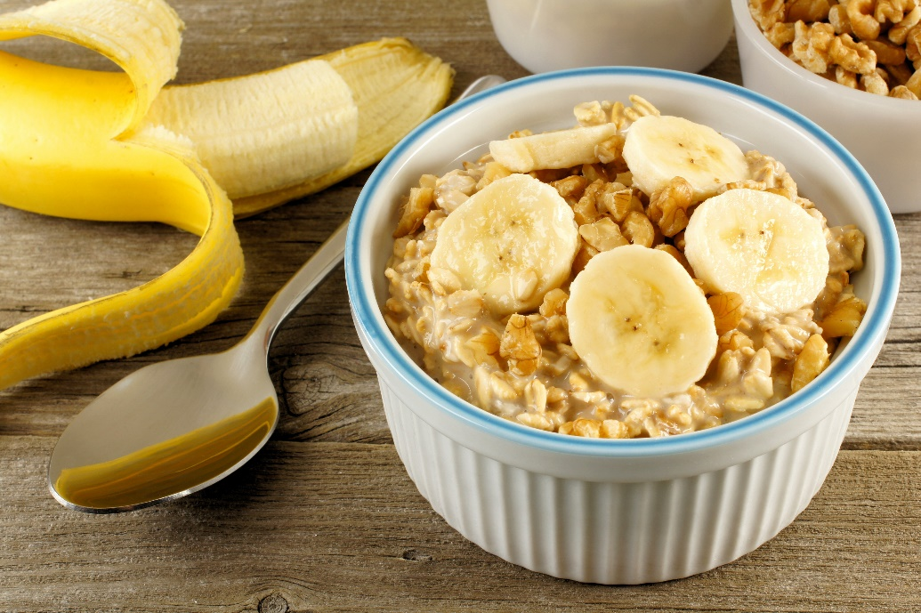
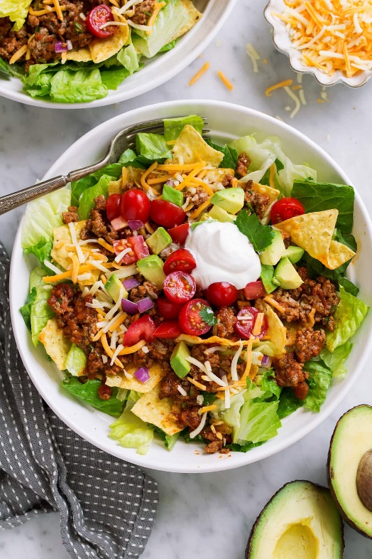
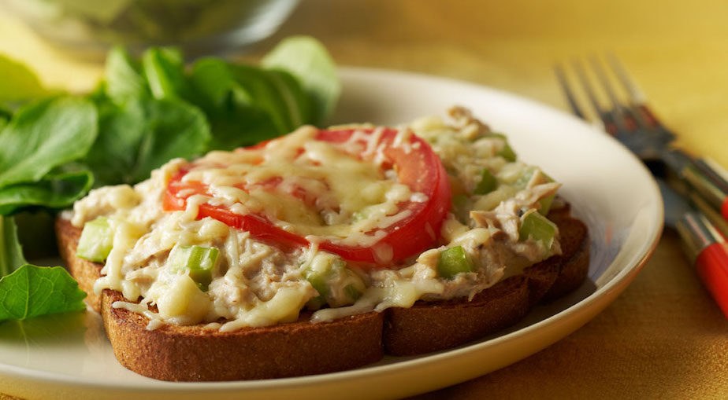
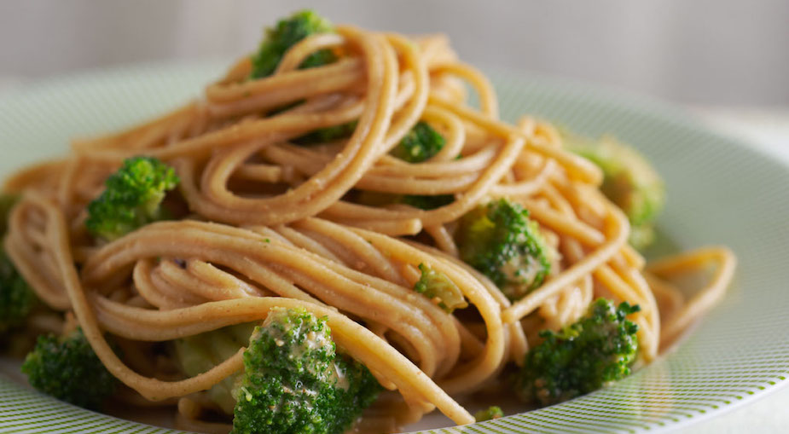

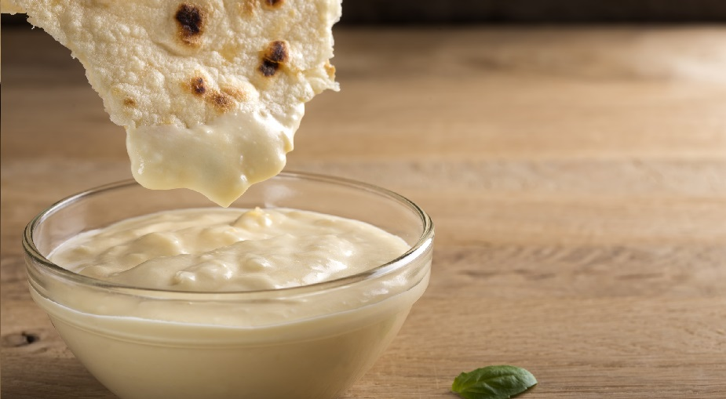
With those food items, you could make…
Check out these recipes on WICHealth!
Breakfast: Breakfast Casserole and Creamy Banana Walnut Oatmeal
Lunch: Taco Salad and Tuna Melt
Dinner: Easy Chicken and Vegetables and Noodles with Peanut Sauce
Snack: Fruit Smoothie and Curry Yogurt Dip
Notes:
SAY: All of your ideas sounded great! Let’s take a look at some recipes that WICHealth came up with using these same ingredients.
SAY: If any of these recipes sound good to you and you might want to try them, you can find them on WICHealth.org!

Slide 23

Reflection
What is one new thing you learned about budget-friendly meal planning?
What is one meal planning strategy you plan to incorporate into your family’s routine this week?
Notes:
SAY: Now we are going to take some time to reflect on what you learned, and to make a plan for adding what you learned today into your family’s routine this week.
SAY: In thinking about today’s presentation, what is one new thing you learned about budget-friendly meal planning? You can raise your hand (or if virtual), unmute yourself and share.
What is one meal planning strategy you plan to incorporate into your family’s routine this week?
SAY: Thank you for sharing! So glad to hear all those great ideas that you plan to start using in your daily lives!

Slide 24

Questions?
Notes:
SAY: Does anyone have any questions?

Slide 25





Thank You!
Notes:
SAY: Thank you all so much for your time today! If you have any further questions, please reach out to your WIC Nutritionist.

