Slide 1
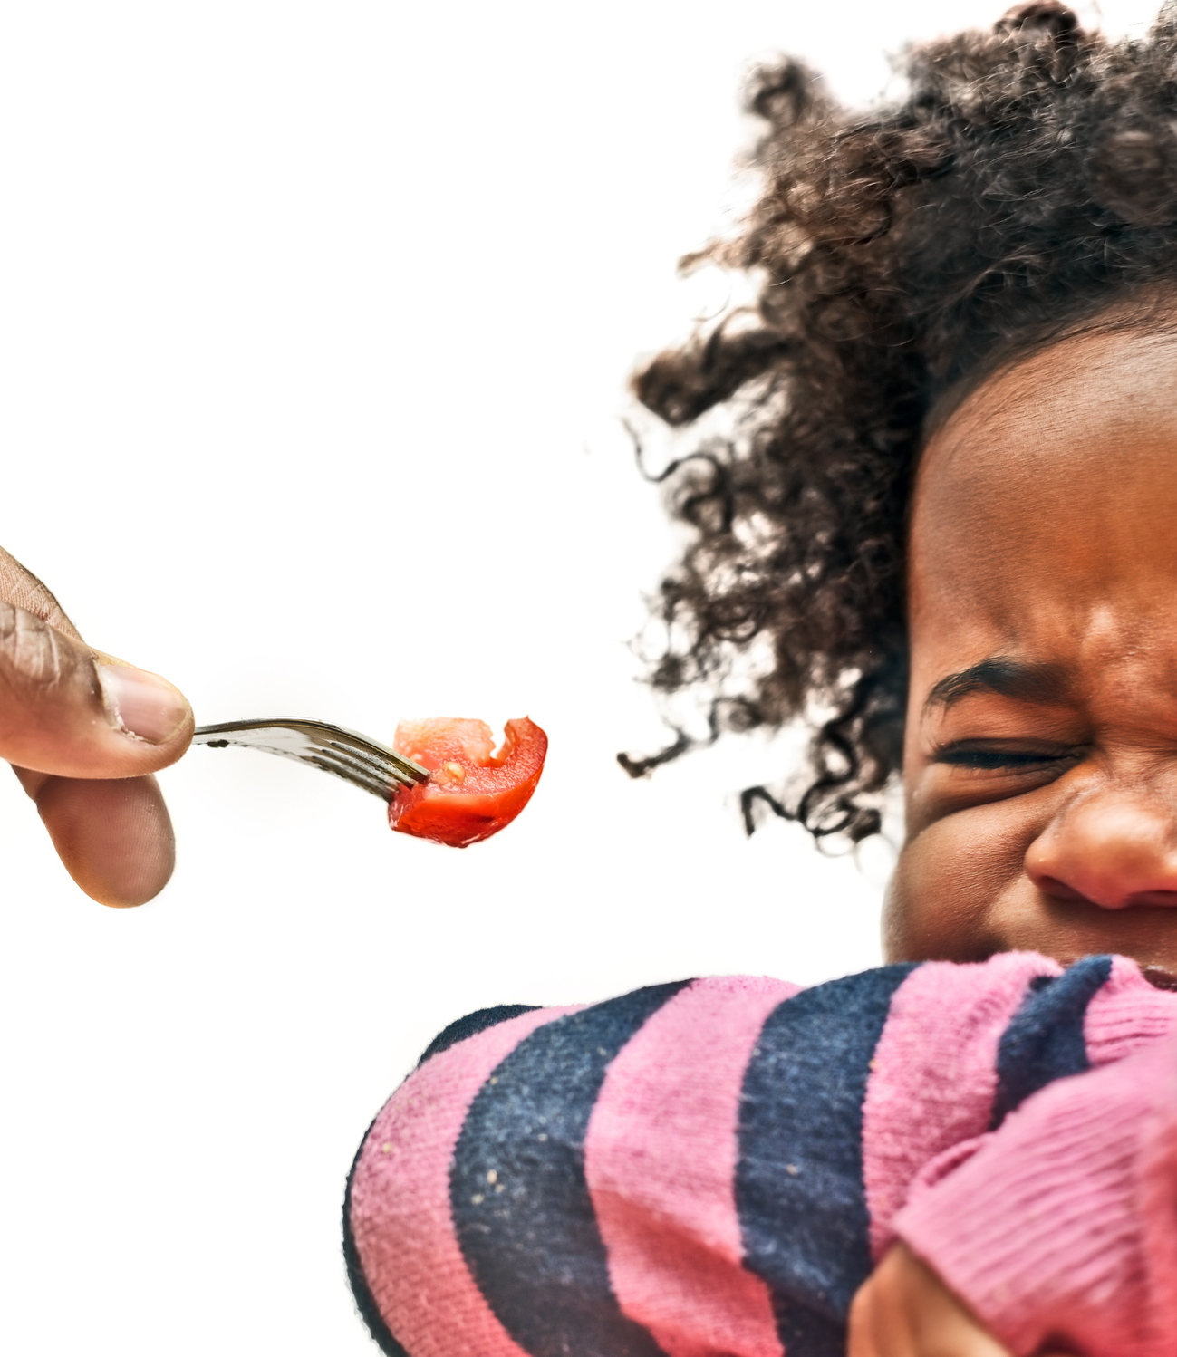
PICKY EATING
WIC Talks
Notes:
SAY: Welcome, everyone! Today, we’re going to talk about picky eating—a common challenge many families face. Whether it’s a toddler refusing anything green or a school-aged child who only eats pasta, picky eating can feel overwhelming for parents and caregivers. But don’t worry! We’ll explore ways to make mealtimes less stressful and help your child try new foods in a positive way.
SAY: Before we begin let’s take a few minutes to get to one each other. Please share your name and the ages of your children. We will go first (trainers introduce yourselves)
SAY: Thank you so much for sharing. Now we would like to you to share your thoughts with on your child’s picky eating.
What food has your child found most difficult to try lately? [Pause to allow participants to share their responses and acknowledge common themes.]
SAY: Thank you all for sharing. It’s clear that picky eating can take many forms, but the good news is there are strategies that can help.

Slide 2
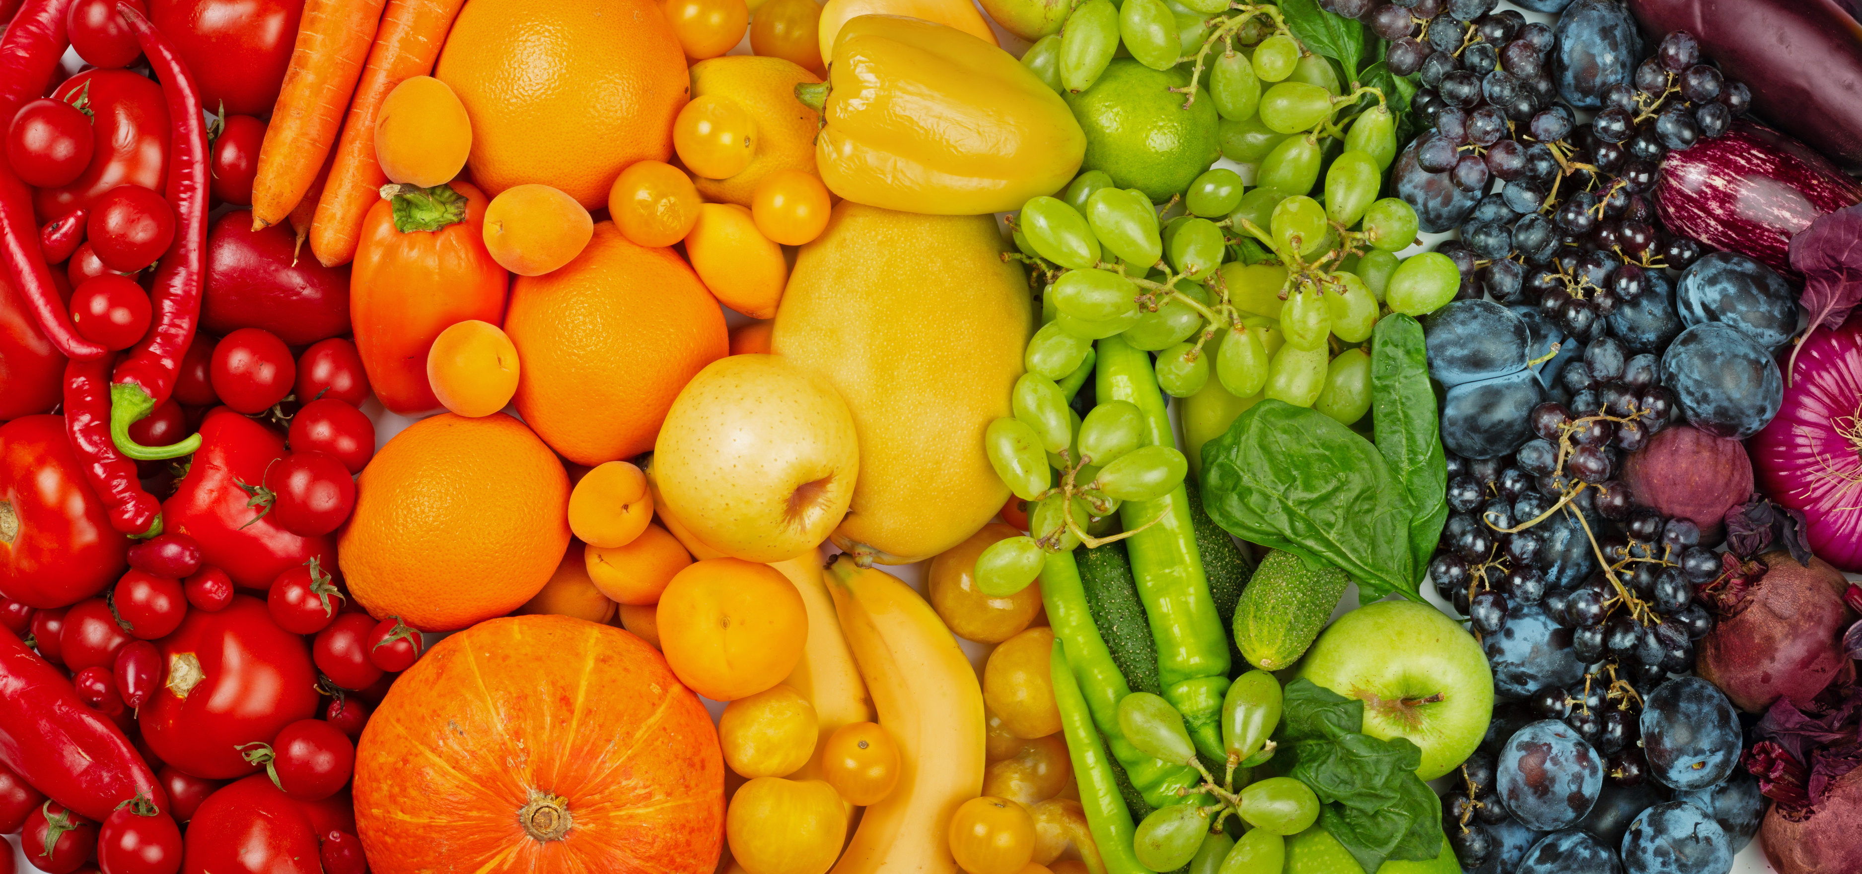
GOALS
  Identify the causes of picky eating
  Build practical skills for helping your picky eaters
  Learn what to do and what not to do when introducing new foods
Notes:
SAY: Today we will focus on 3 key objectives:
Identifying the underlying causes of picky eating
Build practical skills using real life mealtime scenarios and
Learning effective strategies to introduce new foods to better manage everyday situations

Slide 3

UNDERSTANDING PICKY EATING
Notes:
SAY: Picky eating can look differently for each child. Some might refuse entire meals while others might reject specific foods. Children may have days when they eat everything and days when they refuse everything. The more you understand these behaviors the better equipped you will be to address them effectively.

Slide 4

WHAT IS
PICKY EATING?
    Often refuses certain foods or eats only small number of foods
    Strong food likes and dislikes
    Does not want to try new foods
Notes:
SAY: Picky eating is when a child is very choosy about the foods they eat. Many picky eaters:
SAY: Often refuse certain foods or eat only a small number of foods. Some children may only want to eat a few favorite foods and say “no” to many others.
SAY: They have strong likes and dislikes about food. They may love one food one day and refuse to eat it the next.
SAY: They usually do not want to try new foods. New foods can seem scary. Some children need to see and taste a food many times before they feel comfortable trying it.

Slide 5

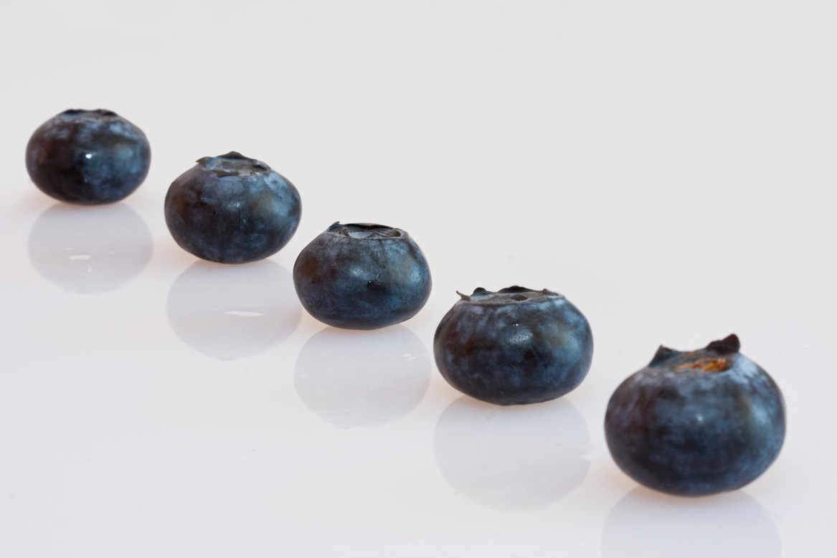


CAUSES OF PICKY EATING
  Increased awareness as to how foods look, feel, taste or smell
  Bad experiences with certain foods
  No regular mealtime routine
  Life changes or stressful events
  Normal part of growing up
Sour
Sweet
Notes:
SAY: There are many reasons why your child might be a picky eater:
Very Aware How Food looks, tastes and feels: Some kids don’t like how certain foods feel, taste, or smell. For example a food might be too “mushy” or “sticky.” They might not like it based on how it looks such as a strong color or if it is mixed with another food. How the food smells could also affect the chances of them trying it.
Bad Experiences: Or a child may have choked or felt sick after eating a particular food, causing them to be afraid to try that food again.
Routines Help: Kids do better when meals happen at the same time every day. Offering the same kinds of food offers a sense of security which can help kids feel better about eating or trying new foods.
Life changes or stressful events—like moving, family problems, or other things at home—can make kids picky about the foods they eat. They might eat less or refuse foods if they feel upset.
Normal Part of Growing Up: One thing to remember is picky eating is normal growth stage for kids, especially between ages 1 and 5. Many kids don’t want to try new foods during this time, but they usually grow out of it with time and patience.
SAY: Have you noticed changes in your child’s eating as they’ve grown? What have you seen?

Slide 6
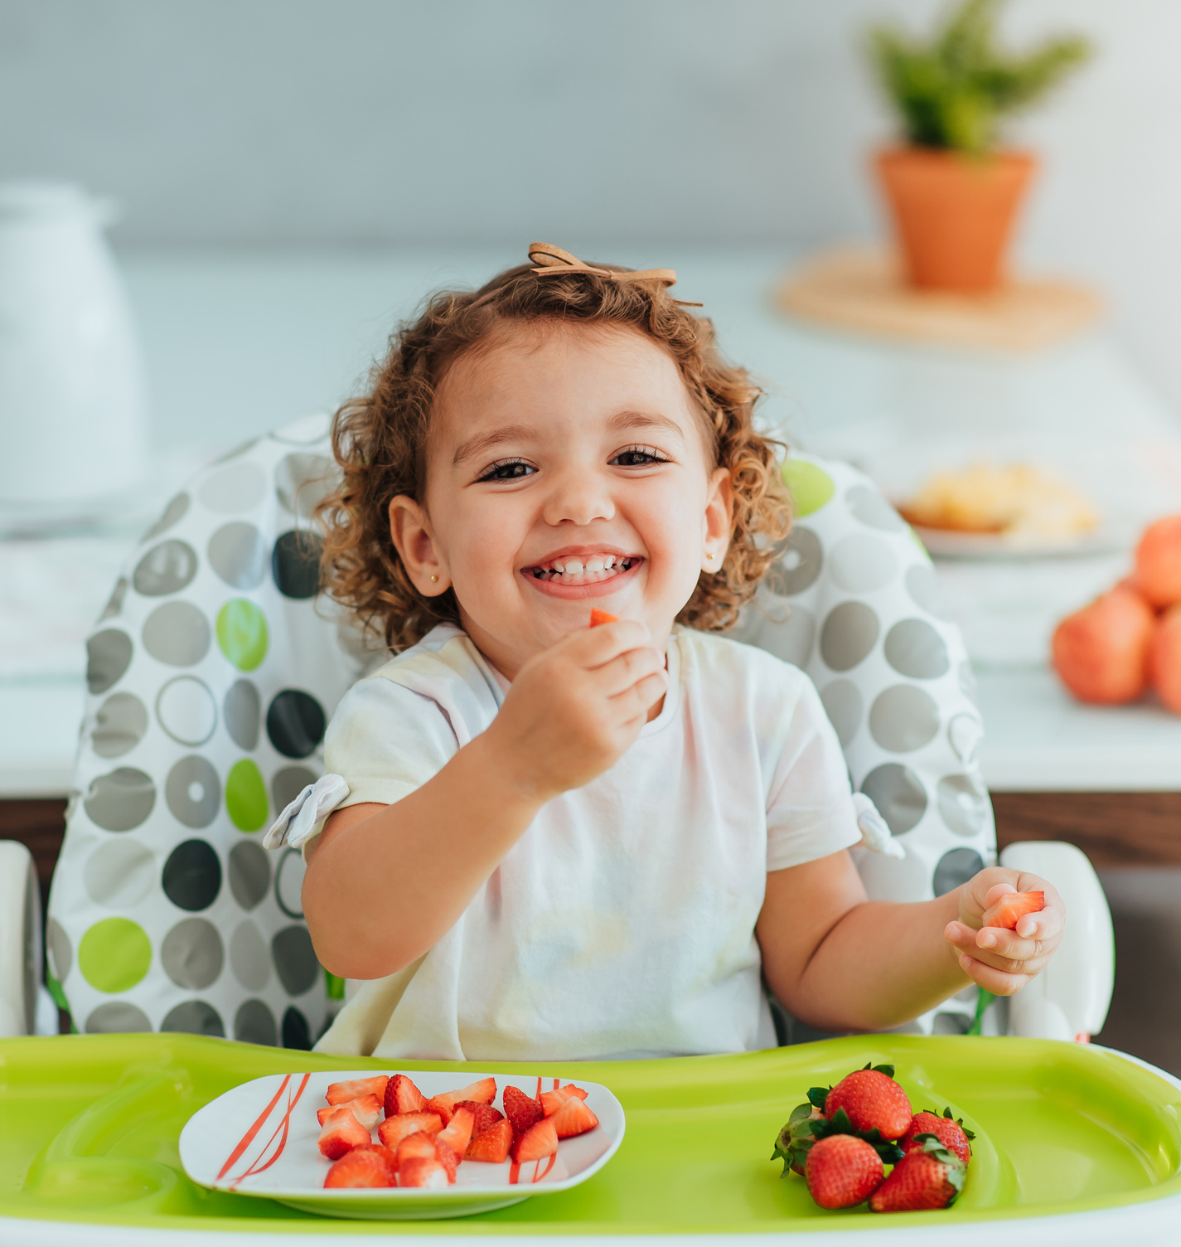
QUESTION:
How many times can it take for a child to accept a new food?
HINK IT MIGHT TAKE FOR A CHILD TO ACCEPT NEW FOOD
A. 3 to 5
B. 6 to 9
C. 10 to 15
The correct answer is C. 10 to 15 times!
Notes:
SAY: Before we discuss strategies for dealing with picky eaters who can guess how many times it can take for child to accept a new food?
(for remote/virtual class) SAY: Type your answer in the chat if you think it is A 3 to 5 times, B. 6 to 9 times or C. 10 to 15 times.
SAY: Raise your hand if you think the answer is A (pause for responses). (then click for B to appear)
SAY: Now those who think B raise your hands. (then click again for C to appear)
SAY: Ok do the rest of you think the answer is C? Raise your hands.
SAY: Those of you that said C are correct! It can take as many as 10 to 15 times before a child feels comfortable enough to eat a new food. Seeing and experiencing the new food even if they don't try it right away helps children become more comfortable with it over time. So don’t get discouraged if your child doesn’t like something right away – its normal!

Slide 7
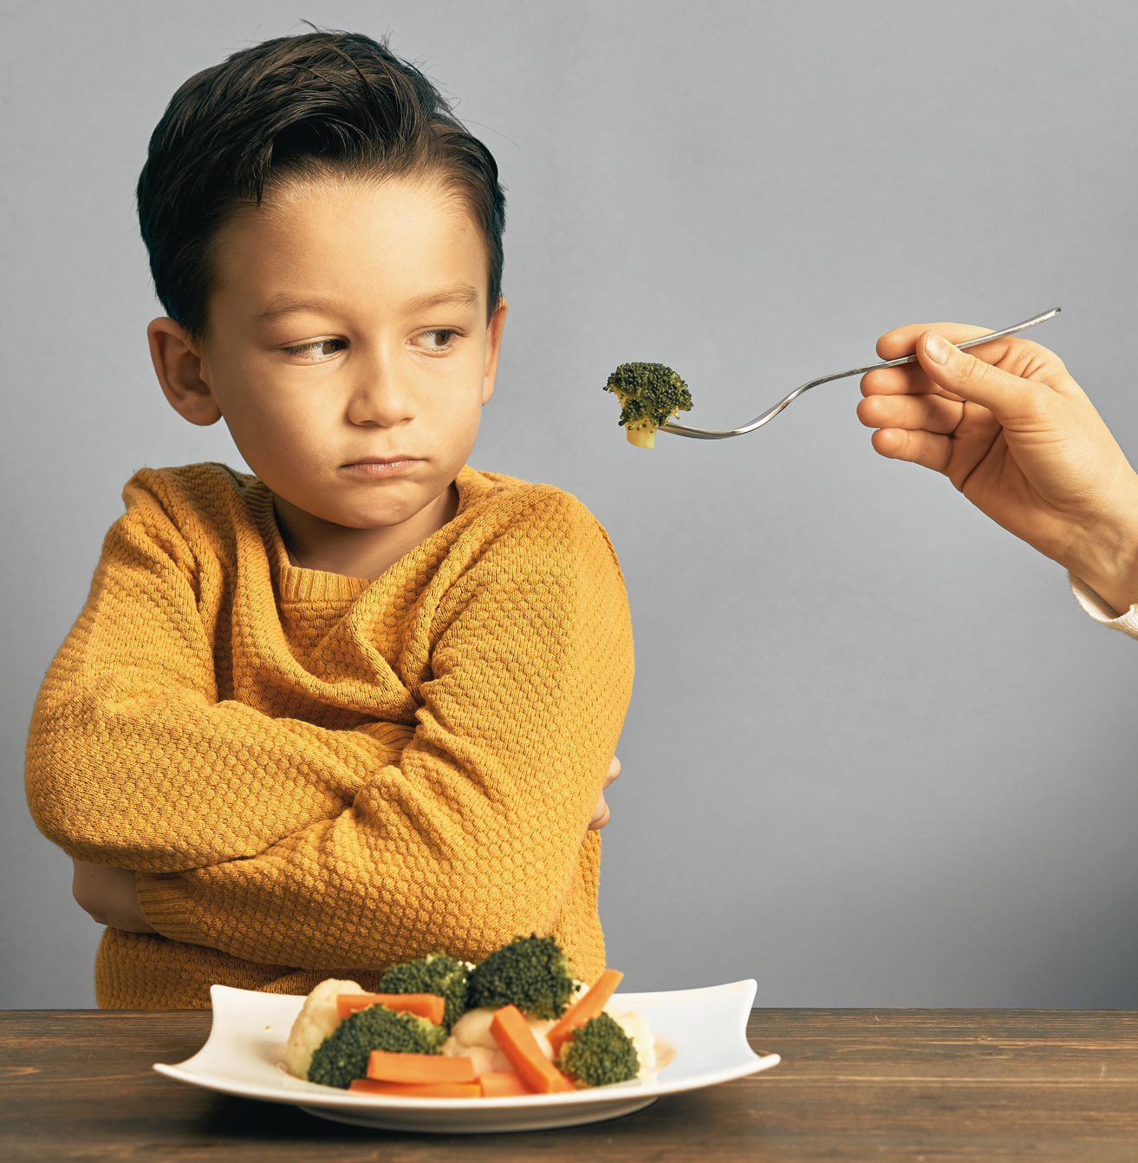
Does this look familiar?
Notes:
SAY: Looking at this image, does it look familiar to anyone? Have you ever been in a situation where your child crossed their arms or turned their head when you offered food?"
[Pause to allow participants to share their experiences.]
SAY: And how do you usually respond when this happens? Do you try to encourage them to eat, or maybe you just move on to something else?"
SAY: What kinds of foods do your kids typically refuse? Are there certain foods they always seem to say ‘no’ to?"
[Encourage a few participants to share.]
SAY: Thank you for sharing! It’s important to know that picky eating is common for kids, and many parents go through this. Next, we’ll explore some strategies to make mealtimes less stressful and help kids feel more comfortable trying new foods
Note to Trainer: If none of participants offer examples for discussion, you can use the example below:
3-year- old Enzo refuses to eat anything green including vegetables likes broccoli, spinach, salad and will only eat pasta and chicken nuggets. Mom worries about his nutrition and struggles to find creative ways to incorporate vegetables into his diet without causing mealtime battles.

Slide 8

Change Strategies
The strategies will center around three main areas of change:
    Foods offered
    Parent behavior
    Family mealtimes
Notes:
SAY: In the next few slides, we will discuss strategies for promoting good eating behaviors with your own families.
SAY: These include:
the food that we offer and how we offer it
how parents behave with their own food (and how that can influence their children’s openness to trying new foods)
and lastly the environment or atmosphere surrounding mealtime.

Slide 9
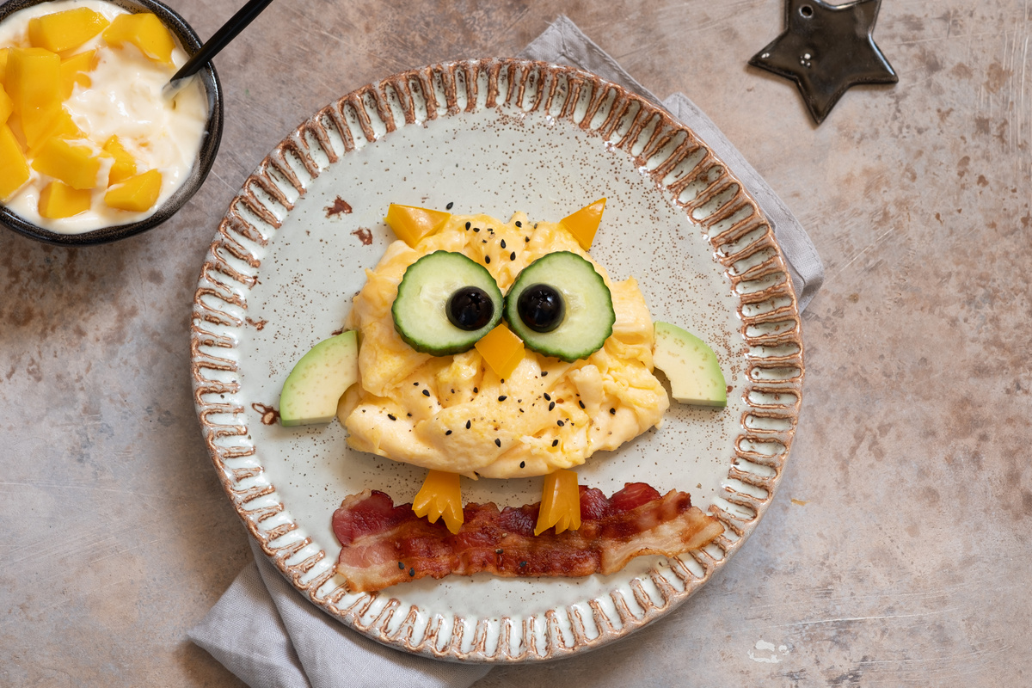
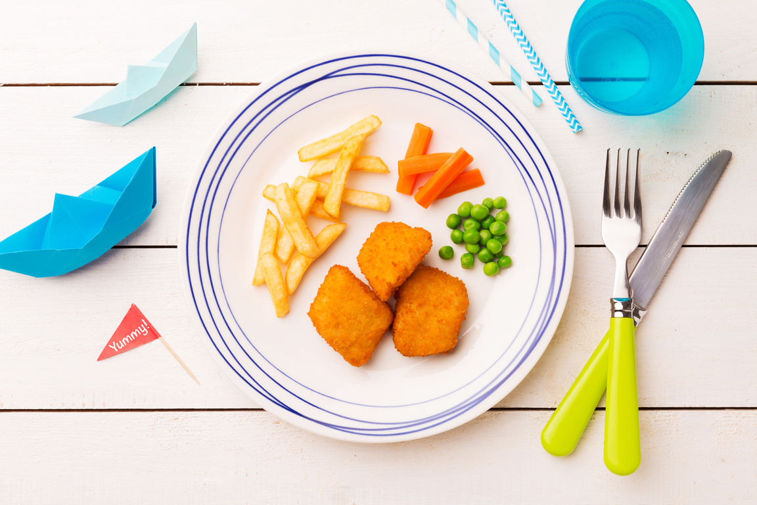
  Offer choices
  Serve new foods with familiar favorites
  Experiment with food presentation
FOOD
Notes:
SAY: One thing you can do to help your picky eater is to provide a variety of foods and let your child choose which one they want. From a very early age children want to make their own decisions so this is a good time to allow them to choose which food (of the ones you provide of course!) they prefer.
SAY: Another strategy is offering a new food alongside a familiar favorite. This provides comfort and security (the favorite food) as well as helps make positive connections with the new food to the familiar one. For example, your child might love macaroni and cheese. To introduce a new vegetable you could try adding small pieces of steamed broccoli into the macaroni and cheese. Start with a very small amount so its not overwhelming and mix it in well. Another option could be to serve the macaroni and cheese as is and place a few carrots or cucumber slices on the side.
SAY: Sometimes the way food is presented can make it more inviting. Some children do not like foods to touch one another. You could serve different foods in sections or use a divided plate to keep them separated. Fun shapes could make the food more appealing. Using a cookie cutter or mold to turn fruit, vegetables or sandwiches into fun shapes or their favorite animal.
SAY: Making food look more inviting by using different colors, shapes or arrangements could make the difference in whether your child wants to try it or not. Just be sure to keep it simple and fun for both you and your child!
SAY: We would love to hear your ideas. Can anyone share any ideas on offering choices, serving a new food with known food or ways of presenting food that they have found to make it fun?
SAY: Those are some great ideas! Thank you all for sharing!

Slide 10


  Model good eating behaviors
  Involve children in meal prep
  Stay calm and keep trying
They are looking at you!
Notes:
SAY: As parents, your behaviors and attitudes toward food play an important role in shaping how your children view food and build healthy eating habits. Here are three key ways you can positively influence your child's relationship with food:
Model Good Eating Behaviors:
Children learn by watching you, so it's important to model healthy eating behaviors. Show them that you enjoy eating a variety of foods—especially fruits, vegetables, and healthy proteins. Make mealtimes enjoyable and relaxed and avoid labeling foods as "good" or "bad." Your positive attitude toward food will encourage them to adopt similar habits.
Involve Children in Meal Prep:
Letting kids help in the kitchen can make them feel more connected to the food they are eating. Simple tasks like washing vegetables, stirring ingredients, or assembling their own plates can spark interest in trying new foods. The more they feel involved, the more likely they are to want to try what they helped prepare.
Stay Calm and keep trying:
It’s important to remain patient. Children may not like a new food the first few times they try it (or the first 15 times!), but don’t give up. Continue offering the food in different ways or at different meals, without pressure.
SAY: By being patient, modeling good habits, and involving your children in the food process, you can help them develop a healthy and positive relationship with food.

Slide 11
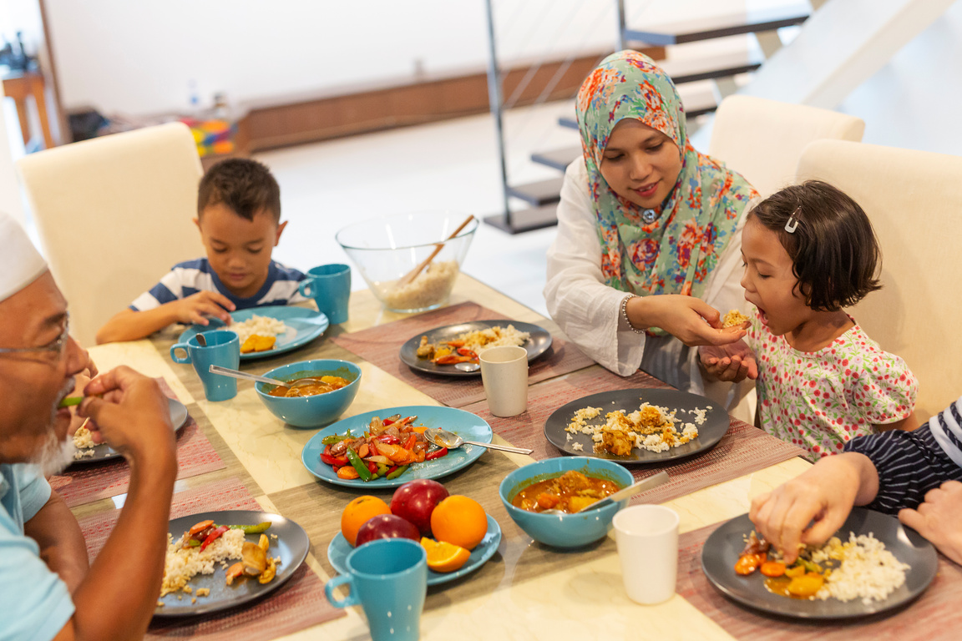
  Strengthen bonds and build connections
  Focus on eating
  Be positive
  Offer praise for trying foods
Fun and focused Mealtimes
Notes:
SAY: Creating a positive mealtime environment is key to helping picky eaters feel more comfortable and open to trying new foods. Let’s look at some ways to set the stage for successful mealtimes:
SAY:
Strengthen bonds and build connections
: One of the best things you can do is to sit down together as a family. This not only gives your child the chance to model positive eating behaviors, but it also strengthens family bonds. Eating together can turn mealtimes into an enjoyable, social experience that your child looks forward to.
Focus on eating
Try to limit distractions during mealtime. This means turning off the TV, putting away toys, and avoiding phones or other electronic devices at the table. This helps your child focus on eating and signals that mealtime is important and not something to rush through or ignore.
Be positive:
How we talk about food matters. Instead of pressuring your child to eat, try using positive and encouraging phrases. For example, "I’m glad you’re trying this" or "You don’t have to eat all of it, but let’s see if you like it." Positive language helps create a relaxed atmosphere where your child doesn’t feel forced or anxious about food.
Offer praise for trying/eating foods
If they try a new food or finish their meal, praise them with specific feedback like "great job trying the broccoli." Celebrating these moments builds their confidence and encourages them to keep making progress.

Slide 12
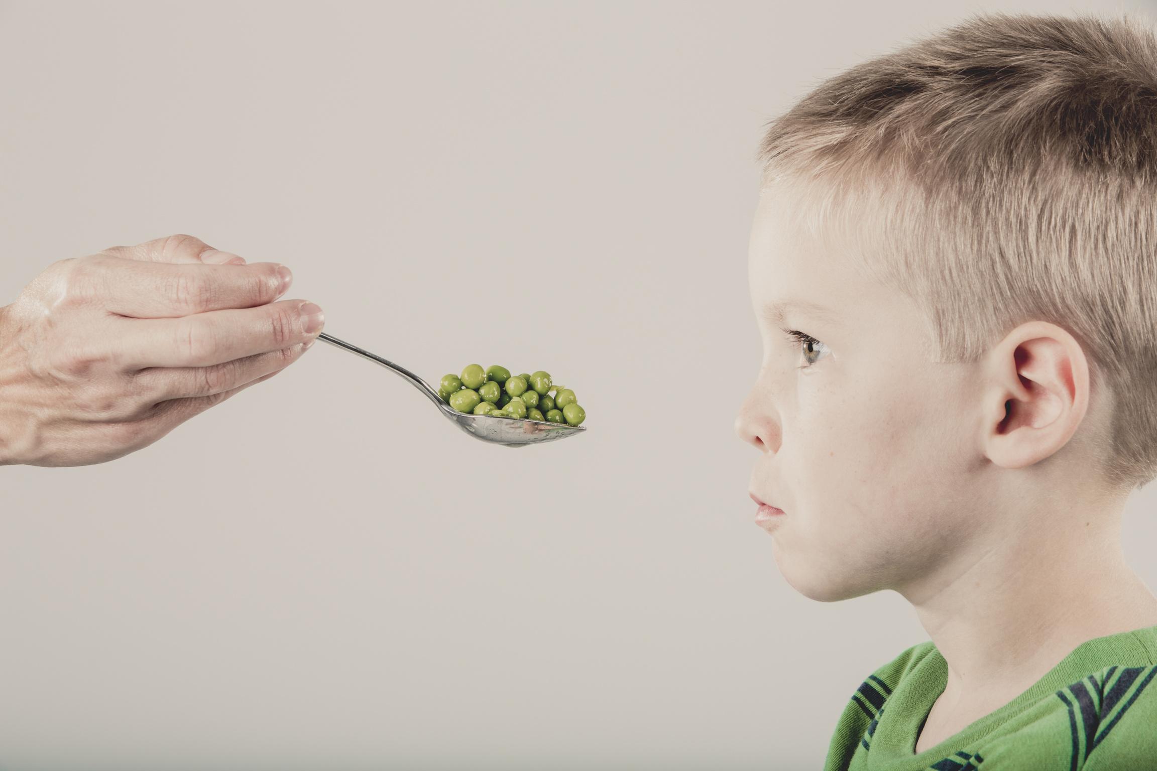
Making mealtime more enjoyable
Notes:
SAY: In the next slide we will share some common pitfalls to avoid when dealing with picky eaters. While it can be frustrating, how we respond to picky eating can influence how children feel about food in the long run.

Slide 13
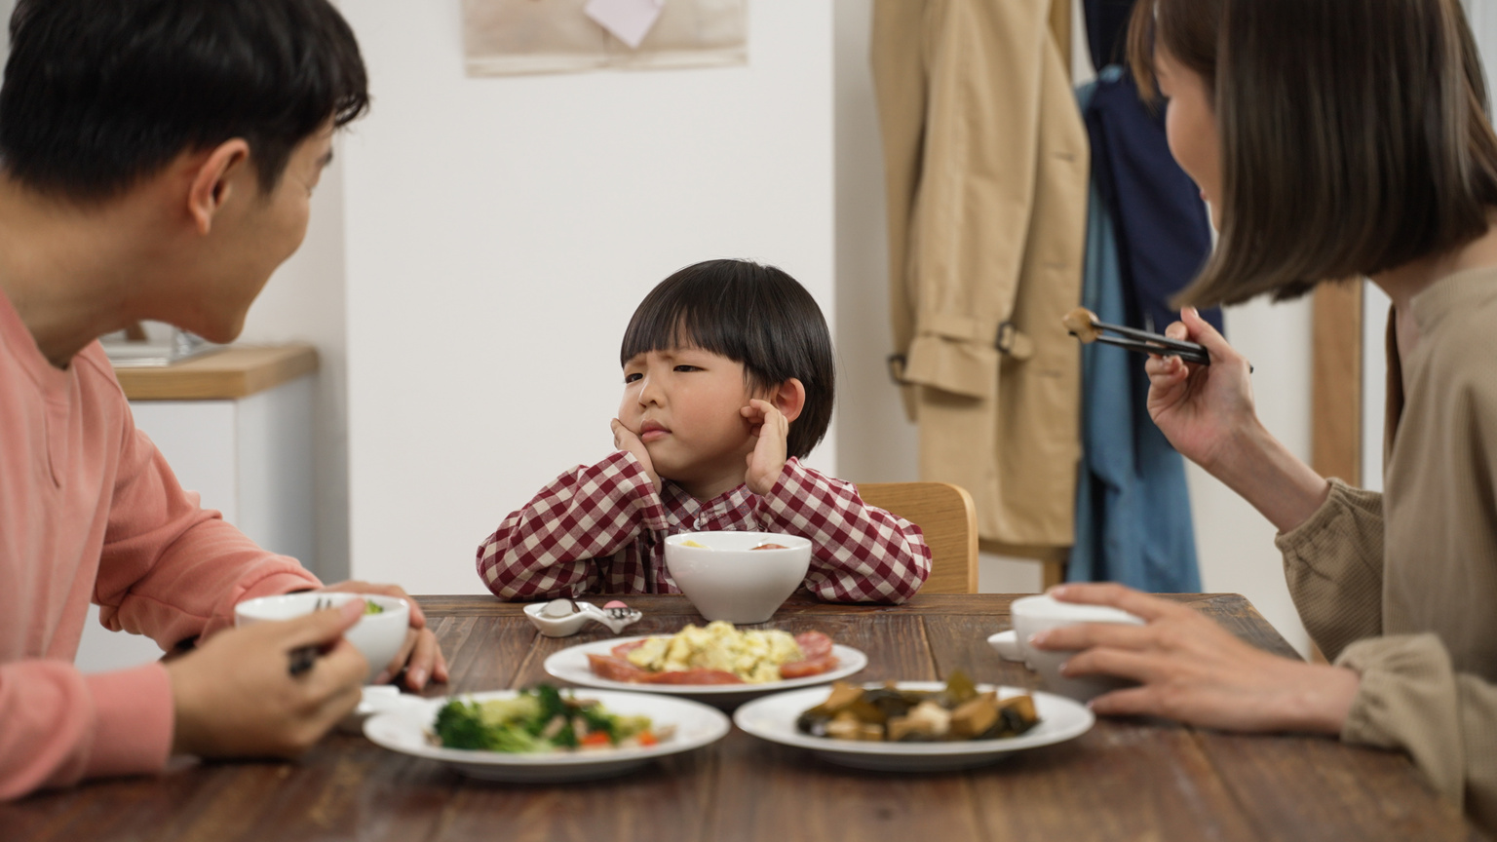
Instead of….
Handling Challenging Mealtimes
Try….
Forcing a child to eat
Letting them choose how much to eat
Nagging or making deals
Staying calm and eating with them
Always offering meal replacement drinks/snacks
Offering regular meals and snacks at set times
Celebrating with praise or extra playtime
Using food as a reward or punishment
Notes:
SAY: Let’s think about some things that might work better when it comes to feeding picky eaters. Instead of forcing your child to eat let them decide how much they want.
SAY: This gives them some control and can help them feel more comfortable with food.
SAY: Instead of begging or making deals, stay calm and try eating with them. This shows that mealtime is a positive time for everyone.
SAY: Instead of using meal replacement drinks or snacks all the time, try offering regular meals and snacks at consistent times to build healthy eating habits.
SAY: And instead of using food as a reward, try celebrating your child’s successes in other ways, like giving them praise or extra playtime. These small changes can make a big difference in creating a more positive eating experience for both you and your child

Slide 14
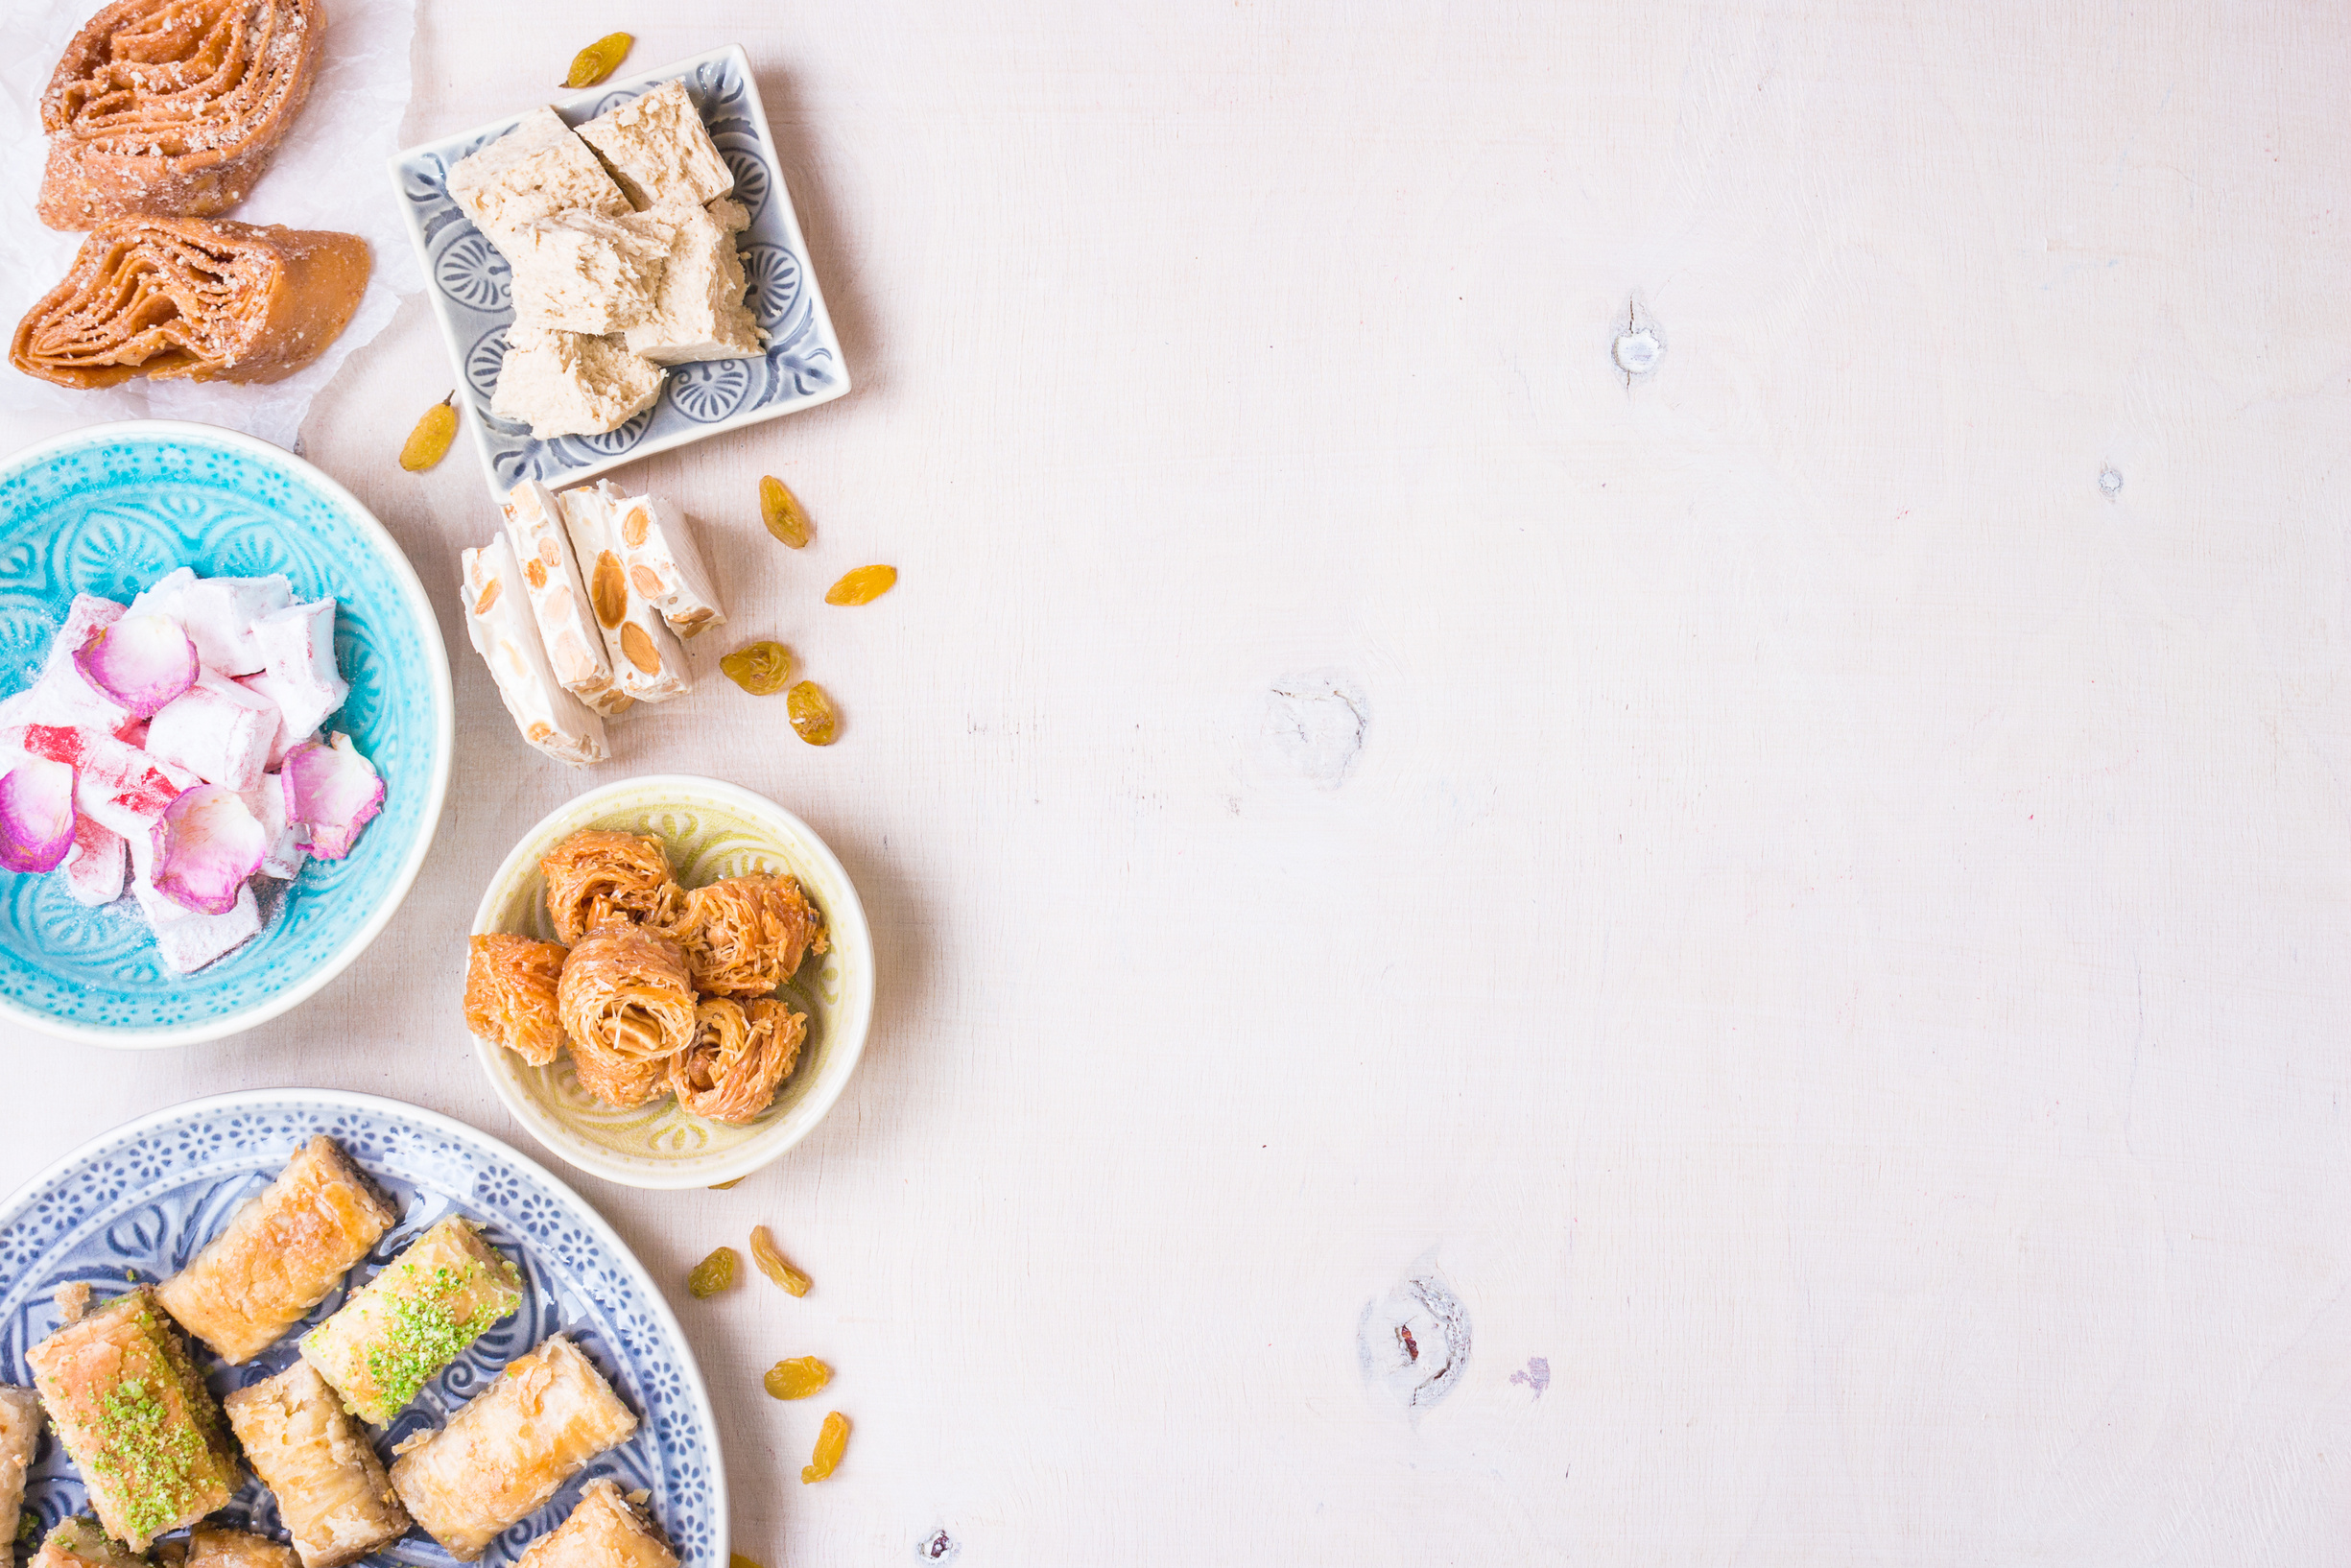
WHAT ABOUT DESSERT?
“I’m fine with letting them choose how much they want to eat. But after they’ve basically eaten nothing, then they want dessert. I feel like I’m getting taken advantage of if I give it to them. If I try to get them to eat more, it’s worse because we end up negotiating the entire meal: “Okay, if you have 3 more bites of meat, you can have a cookie.” It’s gotten to the point that my 6-year-old will ask at the beginning of the meal, “How much do I need to eat in order to have a treat?”
Notes:
(read the example then ask the group):
SAY: Can you think of any alternative strategies the parent could use in this situation?
SAY: What approaches could help encourage the child to eat without resorting to negotiations?
SAY: What are some possible consequences of offering dessert as a reward?
SAY: Have you ever experienced a similar situation? How did you handle it and what was the outcome?

Slide 15

Let’s share!
  Have you tried any of the ideas presented today?
    What worked?
    What didn’t?
  Is there one idea you might like to try?
  What other ideas do you think might help your child try new foods?
Notes:
SAY: Let’s talk about the ideas we shared today. We would like to hear from you.
SAY: Have you tried any of the ideas presented today?
SAY: If yes what worked for you and what didn’t?
SAY: Were there any ideas you found helpful?
SAY: Or if you haven’t tried them yet, is there one new idea you might like to try?
SAY: What other ideas do you think could help your child try new foods and be more open to different meals?
SAY: Thank you all for sharing your experiences. This is a great way to support one another in finding what works best for each of us.

Slide 16

SUMMARY
  Causes of picky eating may include:
    Increased awareness as to how foods look, feel, taste or smell
    Past bad food experiences
    Normal growth and development
    Lack of routine or familiarity
    Stressful family events
  Important to be a good role model
  Make mealtimes about family and fun
Notes:
SAY: Let’s quickly review what we’ve talked about with picky eaters.
First, picky eating can be caused by many things. Some kids are more aware of how foods taste, feel, smell, or look, and this sensitivity can make them hesitant to try new foods.
A negative experience with a food, like choking or getting sick, can also cause kids to avoid it.
Picky eating is also a normal part of growth and development. Kids go through phases as they learn to explore and trust new foods.
Other factors, like a lack of routine or familiarity with foods, or stress in the home, can also play a role.
SAY: What’s important is how you handle it. Be a good role model—your child is watching how you eat and react to foods.
And remember, mealtimes should be about family and fun. Keep the focus on spending time together rather than on who is eating what. Over time, your child will feel more comfortable trying new foods when meals are calm and positive.

Slide 17
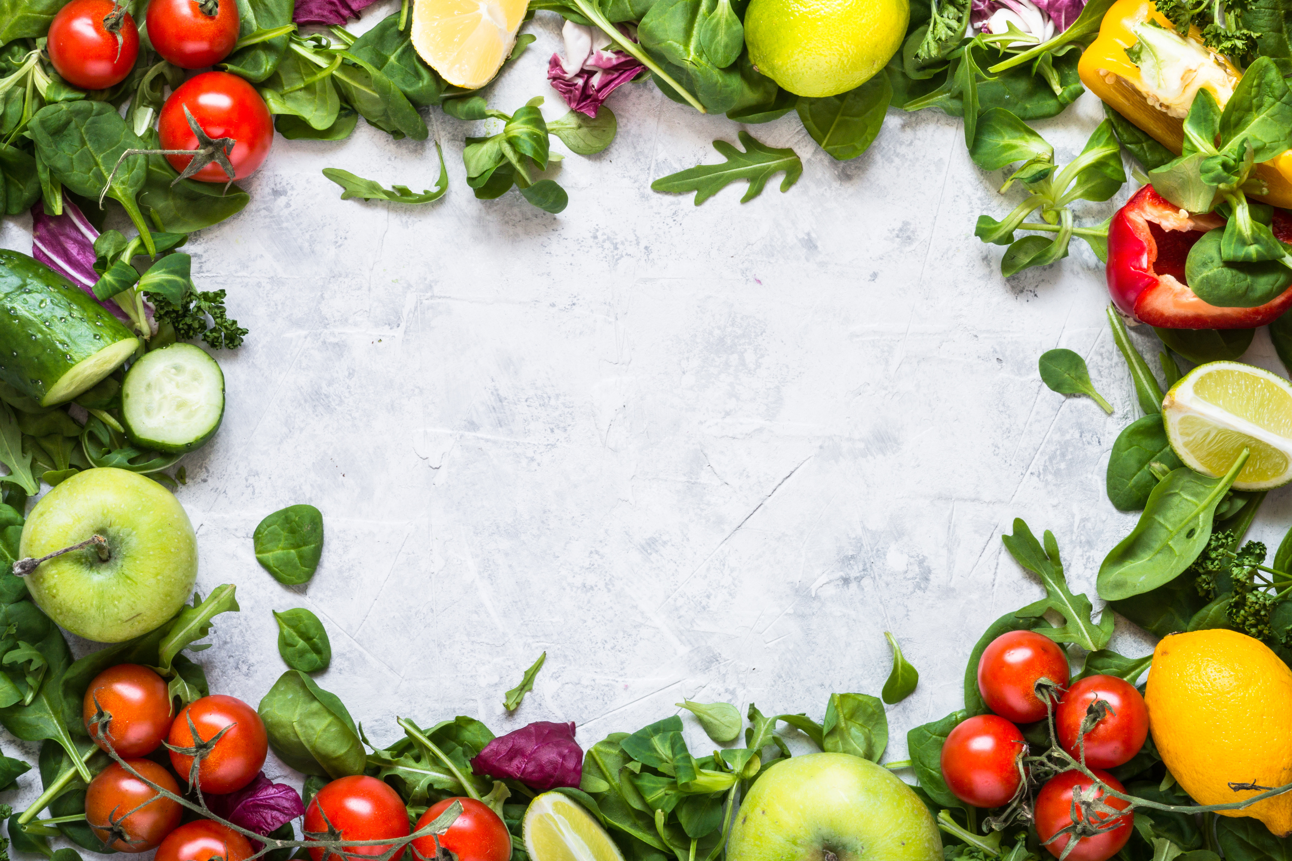
SET A GOAL!
What is one thing you can do this week to support the picky eaters in your family?
Notes:
(Ask the group to share their thoughts in the chat or unmute)

Slide 18
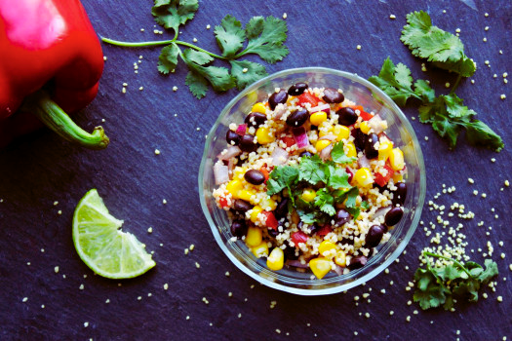
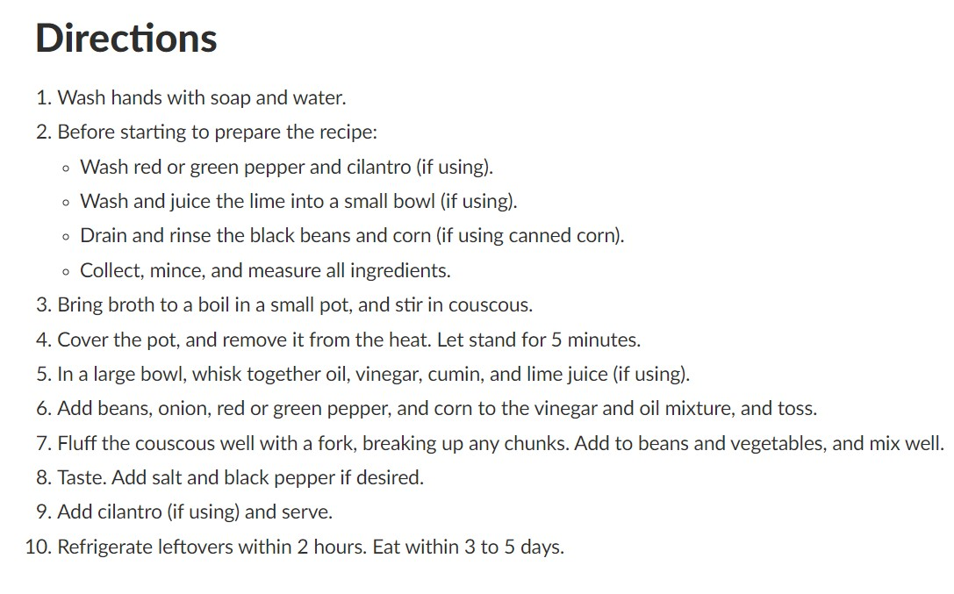
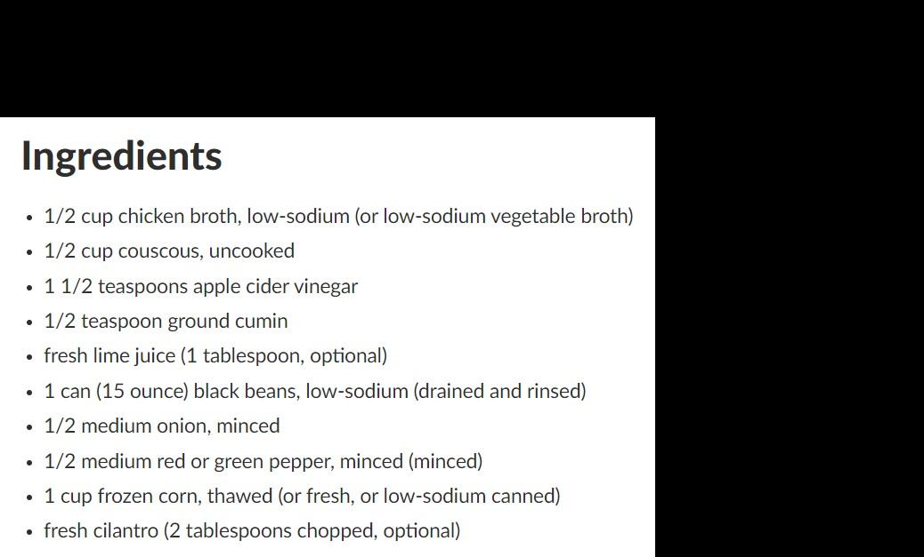

BLACK BEAN AND COUSCOUS SALAD
Notes:
SAY: Before we go wanted to share a simple and nutritious recipe that can be a great addition to your family meals: Black Bean and Couscous.
SAY: This dish is a great way to introduce your child to new flavors and textures in a low-pressure, enjoyable way. It’s quick to prepare, full of fiber and protein, and easily customizable to suit your child’s taste preferences. You can add in different veggies or spices depending on what your child likes, making it a versatile option for a balanced meal.
SAY: When serving, try to keep the presentation simple and fun—maybe shape it into a little ‘mound’ or serve it in a colorful bowl to catch your child’s interest. The key is to keep mealtime relaxed and let them explore new foods at their own pace. Enjoy!

Slide 19


THANK YOU!
  For more resources about picky eating visit the QR code below
Notes:
SAY: Thank you so much for joining us today! We hope you found the information helpful and that you feel more confident in supporting your child’s healthy eating habits Remember picky eating is a normal phase and with patience, flexibility and a few key strategies you can make mealtime more enjoyable for everyone.
SAY: Also for more resources and helpful information be sure to check out the WIC Works website. It has a variety of tools, recipes and tips to support you in your journey.

Slide 20

FOOD TASTING ACTIVITY
Notes:
GUIDANCE:
This is an optional activity so may not be included in all presentations.
Be sure to follow USDA Food Safety Guidelines if you decide to include this activity as part of the presentation.
Suggest having a variety of foods with different textures and colors (e.g fruits, veggies, whole grains, proteins) to keep the tasting exciting
Let participants choose what they would like to try to promote a sense of control.
The goal is to help participants and their families feel comfortable trying new foods and exploring different flavors in a positive environment.
SAY: Let’s switch things up a bit and take a hands-on approach with a fun food tasting activity! This is a great chance to try out some new, kid-friendly foods that you can easily incorporate into your meals at home.
SAY: Here’s how the tasting will work:
You’ll sample a variety of foods that are not only nutritious but also great options for your family. We’ve selected foods that can help introduce new flavors, textures, and ideas into your meals at home.
Take your time to explore the different tastes and see what you like. Remember, this activity is all about discovering new foods and enjoying the process of trying something different.
After the tasting, feel free to share your thoughts or ask any questions. We’re here to discuss how these foods might work in your meal planning and what tips you can use to make them more appealing to your child.
SAY: The goal of this tasting is to introduce new, healthy foods in a relaxed, no-pressure way. You might even find a new favorite that works well for your family! Just keep in mind that the more often you expose your child to different foods, the more likely they are to try and enjoy them

