Slide 1

The Intersectionality of Maternal Mental Health and Medical Risk In Pregnancy & Postpartum Care
Shanita Alvarez-Crawley, LCSW, PMH-C
Director, Postpartum Support International Alliance for People of Color
Maternal and Infant Health Advocate

Slide 2

Agenda
Introduction
Medical Model
Maternal Mental Health
Screening Tools/Considerations
Cultural Considerations

Slide 3
Over 80% of pregnancy relatable deaths in the US are preventable
4 in 5 Pregnancy Related Deaths were Preventable
Black birthing persons are 3 times more likely to die than white counter parts.
Leadings Causes of Preventable Deaths:
Cardiovascular conditions
Infections
Maternal Hemorrhage
Untreated Mental Health Conditions
Notes:
Source CDC.com

Slide 4
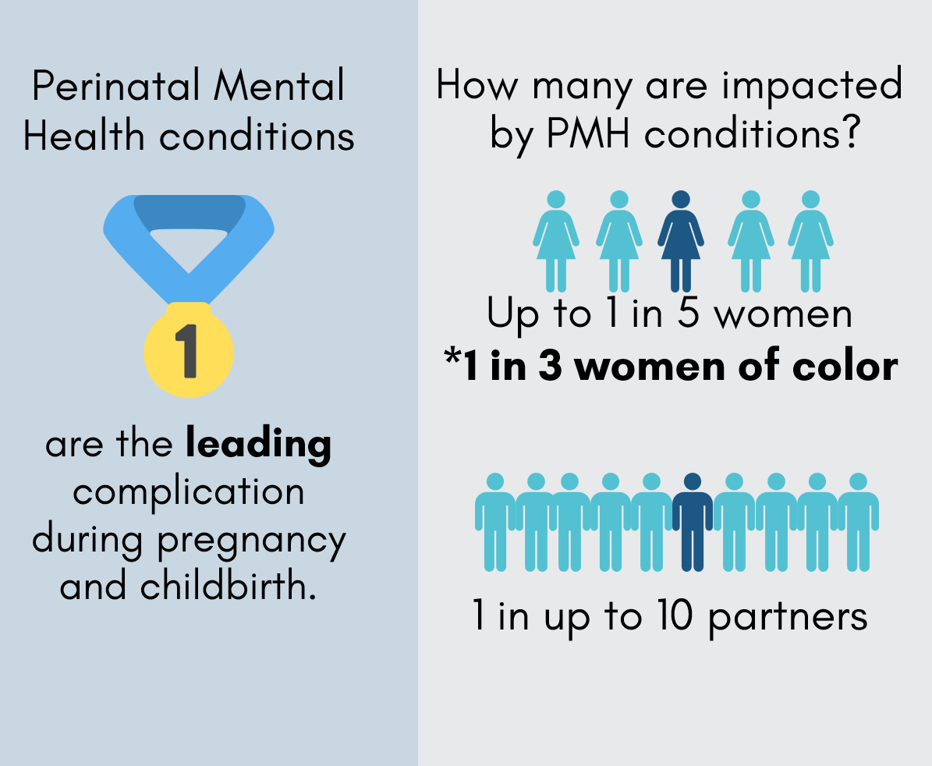
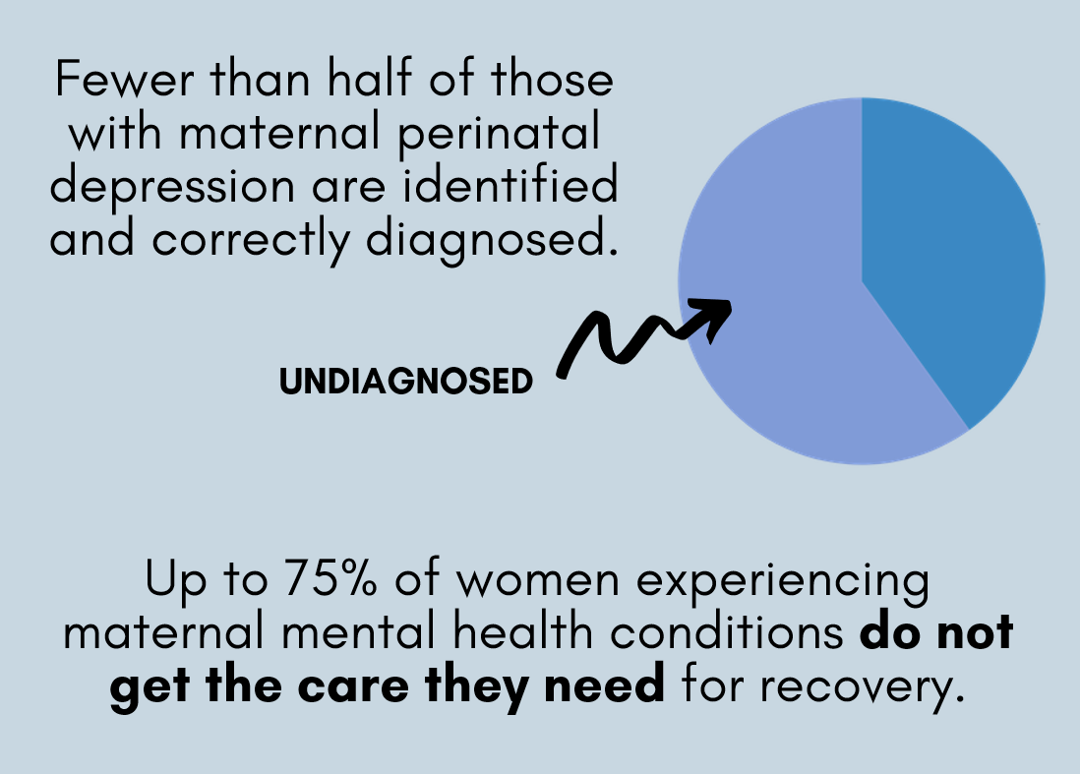
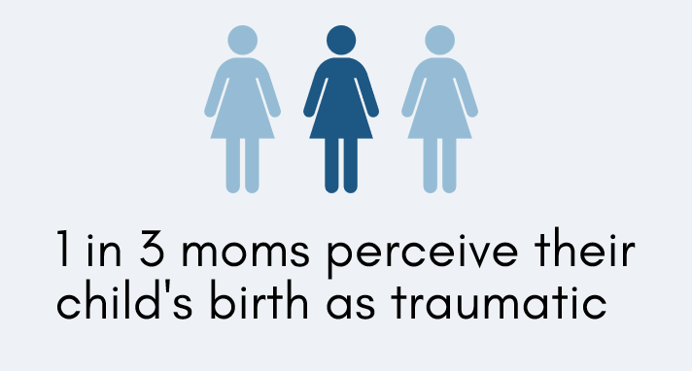
Perinatal Mental Health in the United States
Notes:
Perinatal mental health conditions include mental health conditions occurring in pregnancy or in the first 12 months after delivery, regardless of whether onset occurred before pregnancy or during the perinatal period.
Estimates vary a bit, due to factors like inconsistent screening, overlapping conditions, different ways birthing people may describe their symptoms. That said, rates for perinatal depression and anxiety are both about 1 in 5 – if you know any parents, you probably know people who’ve experienced PMADs.
They can be experienced by birthing people, partners, adoptive parents, and even grandparents – PMADs are a whole-family issue.
Only about 30-50% of people with perinatal mood disorders are diagnosed, and the majority of those who are diagnosed still don’t receive adequate treatment.
Perinatal mental health conditions include mental health conditions occurring in pregnancy or in the first 12 months after delivery, regardless of whether onset occurred before pregnancy or during the perinatal period.
Estimates(of prevalence) vary a bit, due to factors like inconsistent screening, comorbidities of these conditions, diverse ways birthing people may describe their symptoms, or sufferers feeling unsafe or unwilling to express how they’re feeling. That said, rates for perinatal depression and anxiety are both about 1 in 5 – if you work with birthing people, you work with people who are experiencing PMADs.
While you probably hear about postpartum depression most commonly, remember that there are a number of number of conditions under the umbrella of perinatal mood disorders, and that onset may be during pregnancy, not just after giving birth.
They can be experienced by birthing people, partners, adoptive parents, and even grandparents – PMADs are a whole-family issue.
Only about 30-50% of people with perinatal mood disorders are diagnosed, and the majority of those who are diagnosed still don’t receive adequate treatment. We can do better!

Slide 5
Postpartum Depression or the “Baby Blues?”
About 60-80% of birthing people experience the baby blues in the first two weeks postpartum
May be tearful, exhausted; self-esteem unchanged, predominantly feeling well
If the challenges began during pregnancy, are severe, last longer than 2 weeks, or make it hard to function, it’s not the baby blues
Notes:
There are a lot of misconceptions about what’s “normal” after giving birth, and a lot of us are told to expect the “baby blues,” which can make it hard to tell if the way a new parent is feeling is normal or not
The “baby blues” is not a mild form of postpartum depression but rather a reaction to the hormonal change and sleep change. Usually lasts 2-14 days, peaking around 3-5 days postpartum. With support, rest, and good nutrition, the baby blues go away on their own.
If you’re wondering if it’s the baby blues or depression, think about severity and duration. If the way you’re feeling is making it hard to function or you’re struggling after the first couple of weeks, it’s not the baby blues
There are a lot of misconceptions about what’s “normal” after giving birth.
The “baby blues” is not a mild form of postpartum depression but rather a reaction to the hormonal fluctuations of birth and to sleep deprivation. Usually lasts 2-14 days, peaking around 3-5 days postpartum. With support, rest, and good nutrition, the baby blues go away on their own.
If you’re wondering if it’s the baby blues or depression, think about severity, onset, and duration. If your patient is struggling at their six week checkup, it’s not the baby blues

Slide 6

Most Common Symptoms of PMH Conditions
Feelings of guilt, shame, or hopelessness
Feelings of anger, irritability, and rage
Lack of interest in or difficulty bonding with baby
Disturbances in appetite and/or sleep
Constant worry or racing thoughts
Having scary and unwanted thoughts
Higher energy than normal, restlessness
Dizziness, hot flashes, and/or nausea
Difficulty communicating
Possible thoughts of harming self or others
Notes:
While you probably hear about postpartum depression most commonly, remember that there are a number of number of conditions under the umbrella of perinatal mood disorders, and that they may start during pregnancy, not just after giving birth.
There is a lot of overlap between different conditions, as well as symptoms not listed here, but this slide covers many of the most common symptoms you might experience or notice with a perinatal mental health condition.
Something we want to emphasize is that if you don’t feel like yourself, or feel like something just “isn’t right,” you don’t need a diagnosis to reach out for help from PSI.
I hope what you’ll take away from this is that these conditions are common and treatable, and We are here to help

Slide 7
What is the Intersectionality???
Suicide
Infanticide
Substance Use
Increase in preterm birth and low birth rates
Impact on bonding and connection to infant and loved ones
More likely to develop high blood pressure
Difficulty with follow up medical care

Slide 8
Current medical recommendations suggest screening for postpartum depression (1st visit, 6-12 months, Infant Well visit)
Bi-Polar/Postpartum Psychosis
Perinatal Anxiety
Perinatal OCD
Panic Attacks
Racing/Scary Thoughts
Insomnia
Obsession of baby safety
(Traumatic birth experiences increase)
Persistent thoughts or worries related to baby safety
Repetitive actions (checking to see if baby is breathing)
Perfectionism
Linked to bi-polar disorder
Symptoms may appear 2-3 weeks after birth
Mania, depression, paranoia, delusions
Notes:
Source: Postpartum Support International www.postpartum.net

Slide 9
What does this mean for Black Birthing Persons?
Systemic Racism
Toxic Stress
Medical Racism
Cultural Stigma
Fear of Separation
Repeated exposure to systemic bias and inequities
Black birthing persons are more likely to experience social determinants of health
Dismissal of pain
Not believing them when asked for help
Fear of being labeled
Fear of being shamed by community and family of origin
Strong Black Women Syndrome
Weaponization of Mental Health
CPS Reporting
Separation from infant

Slide 10
Why is this important for medical outcomes?
Psychosomatic Symptoms
Women of color are more likely to experience mental health issues somatically such as chronic headaches, high blood pressure, frequent pain.
Notes:
We can’t control for things like hypertension, cardiovascular issues, etc. If we aren’t looking at the mental health and well-being.

Slide 11
Culturally Responsive Care Looks Like….
Trauma informed practice
Coordinated care systems that utilize community-based resources that understand “the language”
Peer Support Models
Validation that individuals know their body and experiences
Cultural humility
Notes:
Goes beyond a check box….

Slide 12
How can you be culturally Responsive?
Active listening
Cultural curiosity
Self reflection/awareness
Authentic Presence and Relationship Building
Notes:
Conversational for audience

Slide 13
Recommended Screening Tools beyond EPDS….
PHQ-9/PHQ-2
Perinatal Anxiety Screening Scale
Mood Disorder Questionnaire
PHQ- 2 Questions
PhQ- 9 questions
31 Questions
17 Questions
Notes:
Be okay with that last question of thoughts of harm…not an indicator of suicide risk immediately…… Opens conversation Allow them to use their language

Slide 14
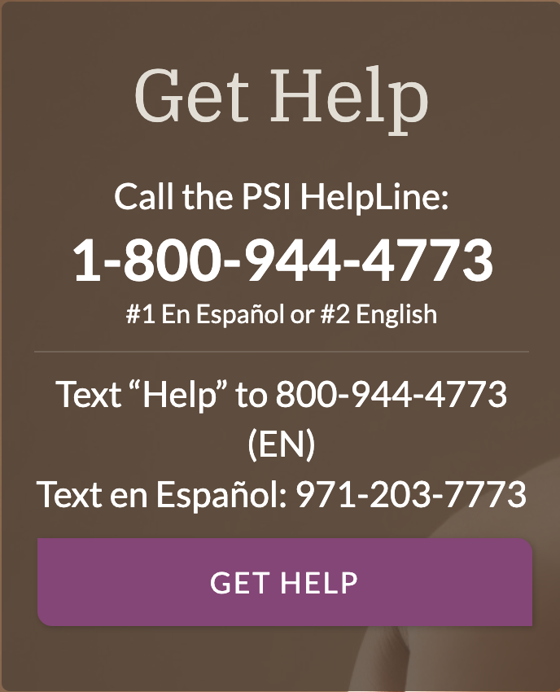
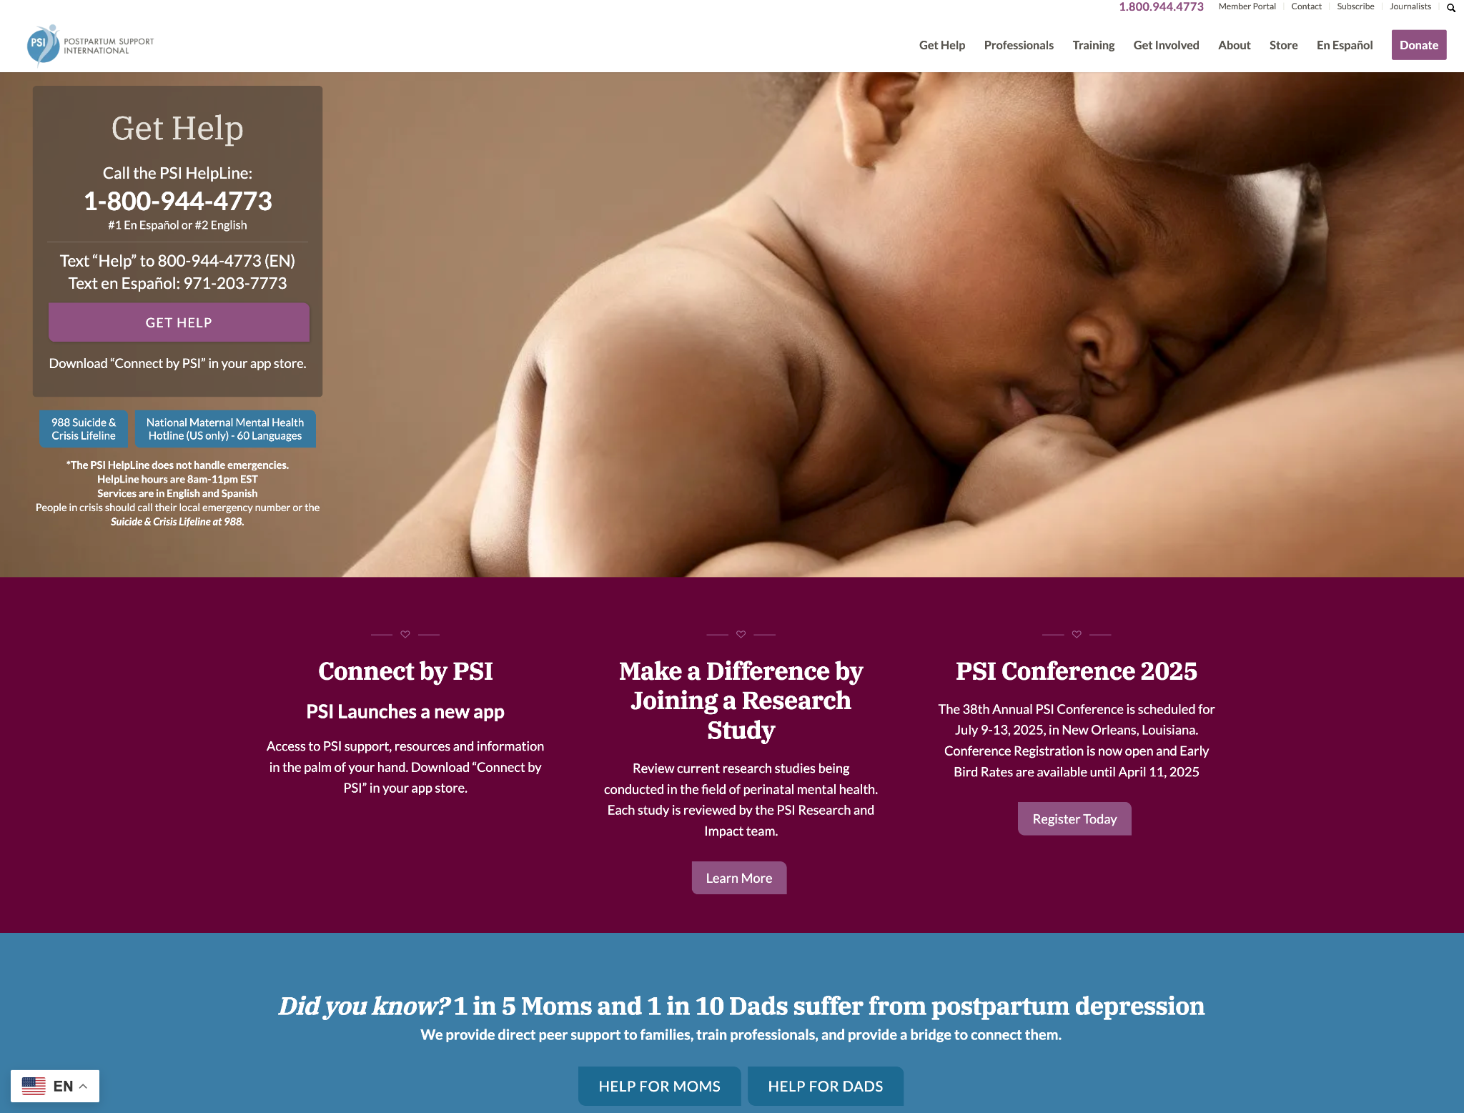
Postpartum.net & PSI Helpline
You can find information and links to all our supports on our website
HelpLine volunteers respond to voicemails and text messages, providing:
  Education
  Support
  Professional referrals
  Offer to connect with local or specialized volunteers & resources
Notes:
In English and Spanish
The website has tons of information and links to resources & support. A great general resource for help seekers that will link them to support and resources. Lots of resources for professionals, and of course all the training and clinical/professional resources we talk about today can be found here.
We also have a free app, which you can download in the app stores, to access PSI from a mobile device if that’s your preference.
We have so many resources that it can be overwhelming! You don’t have to remember everything I’m going to review here. The main thing to remember is that the website has tons of information and links to resources & support.
The PSI helpline is not a crisis service and not answered live. However, it’s a great first step.
How it works: You can leave a confidential voicemail or a text and a trained volunteer will get back to you within one day. (Our volunteers return messages every day between the house of 8 am and 11 pm Eastern). They can listen, answer questions, offer support/encouragement, and connect you with resources.
If you have time, pulling up the website and showing where a few key resources for providers or help seekers are located would be a helpful addition to the presentation.

Slide 15

Crisis Resources
National Maternal Health Hotline
Call or text 833-TLC-MAMA
National Suicide Prevention Lifeline
Dial 988
suicidepreventionlifeline.org
Crisis Text Hotline (24/7)
Text HOME to 741741
Domestic Violence Hotline
Call 800.799.7233
Text START to 88788
Notes:
Reminder that PSI does not provide crisis or emergency services. These and other local crisis resources should be consulted in such cases.
Encourage to have psych emergency protocols in place in addition to physical emergency

Slide 16
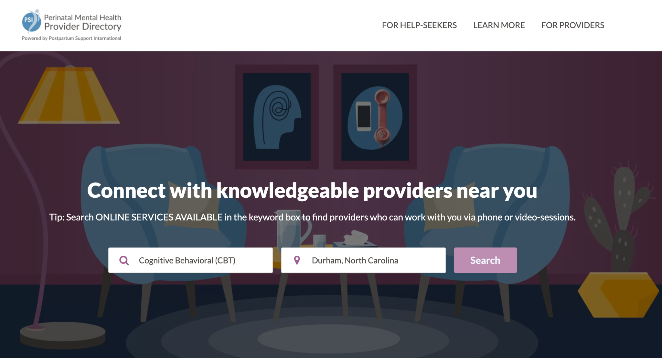
PSI Provider Directory
Continuously updated; can search for professionals who are trained in perinatal mental health
Categories include: mental health, obstetrics, doulas, lactation counselors, support groups, physical therapists, and more!
www.psidirectory.com
Notes:
If you have time in the presentation & are comfortable using it, do a demo of searching the directory to show off how many resources we have in here!
_______________________________
The directory is a tool for help seekers to find providers who are trained in perinatal mental health; providers can also use it as well if they need to make a referral.
It’s free to list your practice in the directory, but requires being in good standing with state or province standards, and that you have completed specialized training in perinatal mental health (this presentation does not qualify!) We even have a Directory Office Hour on the 3rd Thursday of each month at 12:00pm Eastern where we share tips for keeping your listing optimized and updated, discuss new categories, and provide technical support if needed.

Slide 17
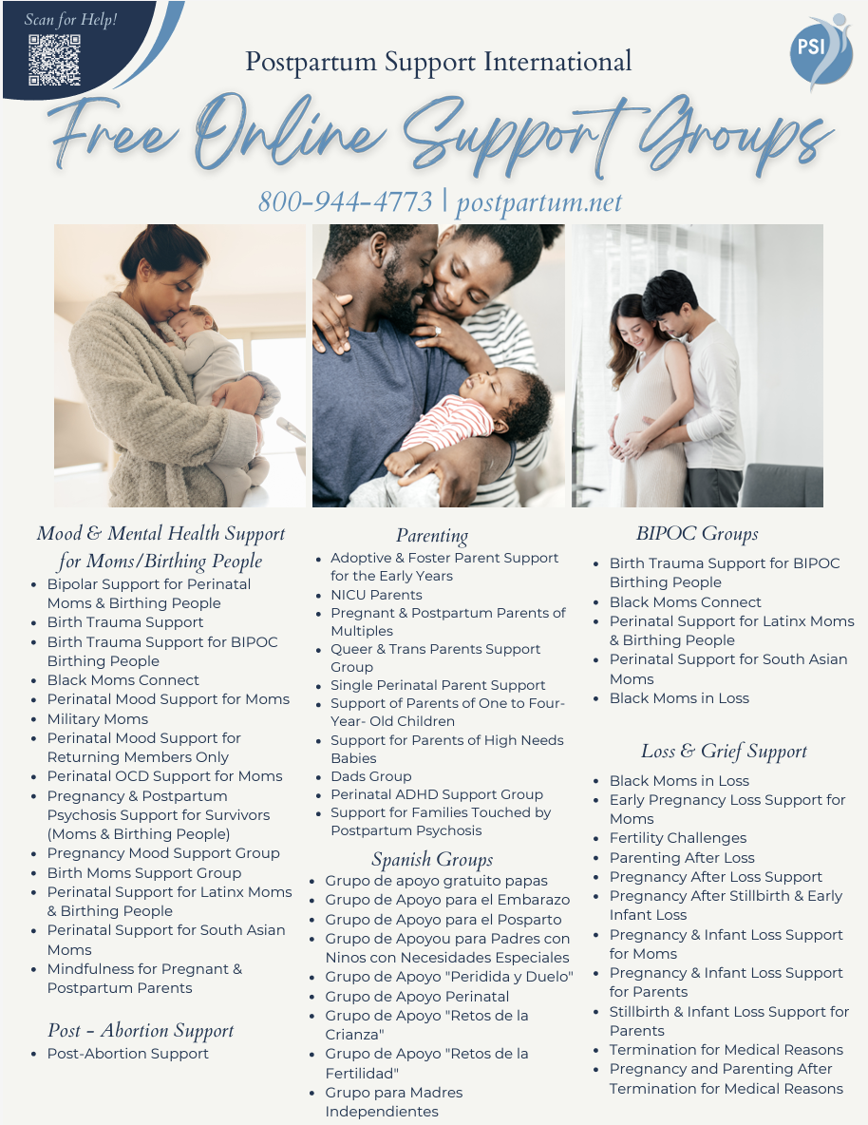
PSI Online Support Groups
50+ free 90-minute support groups focused on a wide range of specialized perinatal needs
Led by trained PSI facilitators
Connect help seekers with other parents and provide helpful tools and resources
Notes:
Social support is an important part of recovery as well as a bridge for many help seekers who haven’t yet been able to get treatment (therapy wait lists, etc). Many of these groups meet weekly and/or have multiple meeting time options to accommodate different schedules. Please encourage your patients to make this part of their care plan! Note: these are peer support spaces for help seekers; professionals/students are not allowed due to confidentiality.
We have dozens of support groups, and we get pretty specific. Groups for conditions (postpartum depression, anxiety, adhd, etc), groups for experiences (loss, adoption, NICU), language (Spanish, ASL), and population (Black mom, military, queer).

Slide 18

PSI: Trainings for Providers
Components of Care (2-day training)
Maternal Mental Health Certificate Course (9 sessions)
Advanced Psychotherapy
Advanced Psychopharmacology
Perinatal Mental Health 101
Perinatal Substance Use Disorders 101
Perinatal Grief and Loss
Foundations in Paternal Perinatal Mental Health
PSI Annual Conference
The 39th Annual PSI Conference is scheduled for
June 24-28, 2026 in Los Angeles!
Notes:
Please update with current training opportunities
____________
We have SO MANY excellent training opportunities for providers like you!
Looking at the first four courses (in dark magenta):
Components of Care training entitles you to list your practice in our directory
Components of Care + either Advanced Psychotherapy or Advanced Psychopharmacology fulfill the educational component to take the PMH-C exam
The two courses with a gold star next to them would be awesome next steps for staff in your practice who want to learn more about perinatal mental health.
We would be happy to connect you with our training department to help you explore your options

Slide 19
PSI: Resources for Providers
Further Professional Development & Engagement
Perinatal Mental Health Certification (PMH-C): creates professional education and evaluation and a standardization of training and experience.
Alliance for People of Color (POC): a program within PSI, aims to fill a gap in support services for professionals and communities of color around PMHDs.
Membership: PSI members around the world receive benefits including online learning/networking groups, consultation, discounts on trainings, and more.
Notes:
Use either this slide or slides 28-29 to mention membership

